Slide 1

Substance Misuse Module
Recovery Concepts, Psycho-social Treatments and Service Development

Slide 2
Insert name of the LEP
Aims and Objectives (from handbook)
To understand principle of recovery and how this is implemented with drug and alcohol services
To gain knowledge of some of the basic concepts of motivation interviewing
To gain knowledge about how services for drug and alcohol are developed
To understand what ancillary services are frequently used with alcohol and drug services

Slide 3
Insert name of the LEP
To achieve this
Case Presentation
Journal Club
555 Presentation
Expert-Led Session
MCQs
Please sign the register and complete the feedback

Slide 4
Insert name of the LEP
Expert Led Session
Psychosocial treatments for people with substance misuse problems

Slide 5
Acknowledgement
Dr Mani Mehdikhani (Principal Clinical Psychologist)
Dr Jan Moring (Consultant Clinical Psychologist)
  Greater Manchester West MH Foundation Trust
  who provided the basis of the presentation

Slide 6
Expert led session
Review models of dependence/addiction
Review evidence base and psychosocial treatments for people with substance misuse problems
Overview of various interventions that are offered in substance misuse: brief interventions, mapping techniques (e.g., ITEP), motivational interviewing overview

Slide 7
Disease model of addiction:
Drug misuse can be conceptualised as a ‘Brain disease’
A diverse range of substances, including opiates, stimulants, cannabis, alcohol and nicotine, produce euphoric effects in the brain.
Euphoria resulting from drug use potentiates further use, particularly for those with a genetic vulnerability.
Chronic drug use produces long-lasting changes in the reward circuits involving dopamine neurons, and intense cravings
Challenge to Theory - Normal process/ Social model a better explanation/ Bioethical concerns
Hall, W., Carter, A., & Forlini, C. (2015). The brain disease model of addiction: is it supported by the evidence and has it delivered on its promises?. The Lancet Psychiatry, 2(1), 105-110.
Heather, N. (2017). Q: Is addiction a brain disease or a moral failing? A: Neither. Neuroethics, 10(1), 115-124.
Notes:
Excerpts from Heather 2017
Addiction and obesity are characterised by changes in the structure and
function of the brain, and that these changes reflect a consequence
of chronic exposure to rewarding, pleasurable stimuli
that in turn increase the motivation to consume those
rewards whilst reducing the ability to control behaviour. But
if these brain changes are indeed an inevitable response to
the repetition of pleasurable acts (rather than something specific
to addictive drugs), then the more parsimonious explanation
is that they are a completely ‘normal’ and predictable
reorganisation of the structure of the brain and change in its
function, rather than hallmarks of a ‘disease’.
Evidence indicates that recovery is a social experience, occurring within social
contexts which change recovery experiences at a subjective
level, with the emphasis on the social and on strengths.
There is also evidence that recovery is more than simply
the reversal of addiction. Hibbert and Best (2011) demonstrated
that those in long-term recovery were ‘better than
well’ with higher life quality following recovery than ‘typical’
non-addict populations, challenging the idea that reco
very is a return to a homeostatic zero
The BDMA ( brain disease model of addiction) as proposed by Leshner (1997) and Volkow
and colleagues (Volkow et al. 2016) has the basic tenet that
repeated substance use leads to brain changes that render
the individual incapable of making certain types of decisions
and choices effectively. In essence, the BDMA suggests that
addiction prevents addicts from making a variety of decisions
about their lives,

Slide 8
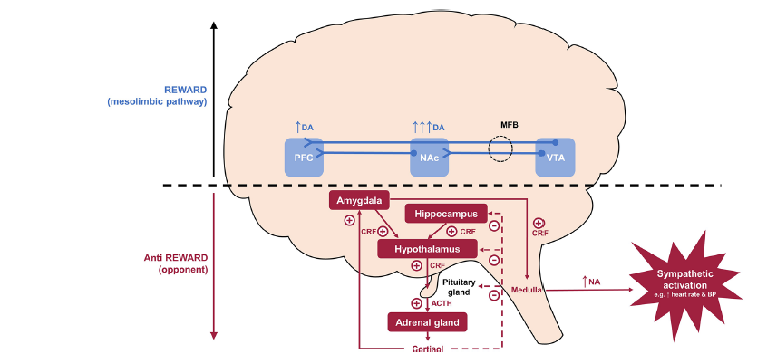
Biological effects of long term drug use
Long terms effects not only on “reward pathways” but also ongoing overactivity of “anti reward pathways”
Kakko, J., von Wachenfeldt, J., Svanborg, K. D., Lidström, J., Barr, C. S., & Heilig, M. (2008). Mood and neuroendocrine response to a chemical stressor, metyrapone, in buprenorphine-maintained heroin dependence. Biological psychiatry, 63(2), 172-177.
Notes:
Biological effect of long term drug use to explain patients symptoms
During acute drug use, the reward system becomes overactive and dopamine is upregulated, especially in the NAc, giving rise to positive reinforcing symptoms, such as drug-liking and euphoria. In the dependent state, the reward system becomes down-regulated and the anti-reward system becomes upregulated and CRF released from the hypothalamic neurons acts on the pituitary to release ACTH, which in turn results in the secretion of cortisol by the adrenal glands. The production of CRF is initially controlled by negative feedback of cortisol on the hippocampus and hypothalamus. However, this is eventually overcome by the production of extra-hypothalamic CRF from the amygdala in a feed-forward manner, which maintains the sympathetic nervous system stress response. This latter pathway produces a stress surfeit that contributes to the negative emotions associated with withdrawal and which goes unbuffered because of the hypodopaminergic tone in the mesolimbic pathway. ACTH, adrenocorticotropic hormone; BP, blood pressure; CRF, corticotropin-releasing factor; DA, dopamine; MFB, medial forebrain bundle; NA, noradrenaline; NAc, nucleus accumbens; PFC, prefrontal cortex; VTA, ventral tegmental area.

Slide 9
‘Alcoholism’ as a disease (Jellinek, 1960)
Underlying principles in AA & NA
IRREVERSIBLE (‘you can go from a cucumber to a gherkin but you can’t go back from a gherkin to a cucumber’)
PROGRESSIVE
INCURABLE (always ‘recovering’ never ‘recovered’)
Characteristics of the model: Inability to control drinking or use
Goals of treatment: Long term abstinence

Slide 10
The 12 Steps 1-6
We admitted we were powerless over alcohol - that our lives had become unmanageable.
Came to believe that a Power greater than ourselves could restore us to sanity.
Made a decision to turn our will and our lives over to the care of God as we understood Him.
Made a searching and fearless moral inventory of ourselves.
Admitted to God, to ourselves and to another human being the exact nature of our wrongs.
Were entirely ready to have God remove all these defects of character.
Notes:
The Birth of AA
https://www.aa.org/pages/en_US/historical-data-the-birth-of-aa-and-its-growth-in-the-uscanada
AA had its beginnings in 1935 at Akron, Ohio, as the outcome of a meeting between Bill W., a New York stockbroker, and Dr. Bob S., an Akron surgeon. Both had been alcohol dependent
Prior to that time, Bill and Dr. Bob had each been in contact with the Oxford Group, a mostly non-alcoholic fellowship that emphasized universal spiritual values in daily living. In that period, the Oxford Groups in America were headed by the noted Episcopal clergyman, Dr. Samuel Shoemaker. Under this spiritual influence, and with the help of an old-time friend, Ebby T., Bill had gotten sober and had then maintained his recovery by working with other alcoholics, though none of these had actually recovered. Meanwhile, Dr. Bob's Oxford Group membership at Akron had not helped him enough to achieve sobriety.
When Dr. Bob and Bill finally met, the effect on the doctor was immediate. This time, he found himself face to face with a fellow sufferer who had made good. Bill emphasized that alcoholism was a malady of mind, emotions and body. This all-important fact he had learned from Dr. William D. Silkworth of Towns Hospital in New York, where Bill had often been a patient. Though a physician, Dr. Bob had not known alcoholism to be a disease. Responding to Bill's convincing ideas, he soon got sober, never to drink again. The founding spark of Alcoholics Anonymous had been struck.
The venue for AA's first meeting in Great Britain was pretty classy - London's Dorchester Hotel. Grace O, an American AA, visiting London had been asked by GSO in New York to contact several people in Britain who wanted information about AA. Amongst them were Chris B, probably the first person in England to use AA to attain sobriety, 'Canadian' Bob B, an American serviceman Sergeant Vernon W, and Norman R-W, who was still drinking. The meeting was held in Room 202 of the hotel at 8 p.m. on Monday 31st March 1947. Others attending the meeting were Tony F, an Irish airman, Flash W, an American and Pat G, a female member from California whom Grace had met on the voyage.
In the same way that early American meetings had been held in members' homes meetings were held in Canadian Bob's house in Mortlake Road, Kew Gardens as well as in cafés.
Progress was slow at first but when Canadian Bob visited new members Alan and wife Winnie in Bolton he informed them that they were the Bolton Group. In November 1948 the Group held its first meeting in the Millgate Hotel, Manchester

Slide 11
The 12 Steps 6-12
Humbly asked Him to remove our shortcomings.
Made a list of all persons we had harmed, and became willing to make amends to them all.
Made direct amends to such people wherever possible, except when to do so would injure them or others.
Continued to take personal inventory and when we were wrong promptly admitted it.
Sought through prayer and meditation to improve our conscious contact with God as we understood Him, praying only for knowledge of His will for us and the power to carry that out.
Having had a spiritual awakening as the result of these steps, we tried to carry this message to alcoholics and to practice these principles in all our affairs.

Slide 12
Recovery Model of Addiction
58% of people with a lifetime addiction will ‘recover’.
Recovery is predicted by: exposure to role models, and a sense of purpose and meaning.
Recovery involves personal changes in both beliefs (about reduced use, and abstinence where it is both desired and realistic) and skills (coping skills, practical abilities), as well as social capital (non-using support).
Recovery is also a social movement where visible recovery champions can generate a social contagion of hope.
Best, D. W., & Lubman, D. I. (2012). The recovery paradigm: A model of hope and change for alcohol and drug addiction. Australian family physician, 41(8), 593.

Slide 13
NICE guidance
Brief interventions
Can use in a variety of settings for people not in contact with drug services and for people in limited contact with drug services
Suggest not to provide group psychoeducational interventions about reducing BBV risks / injecting
Opportunistic brief interventions focused on motivation should be offered to people in limited contact / no contact with drug services
  2 sessions each lasting 10–45 minutes.
  explore ambivalence - drug use and possible treatment
National Institute for Clinical Excellence. (2007). Drug misuse in over 16s: psychosocial interventions. Manchester: National Institute for Health and Clinical Excellence.
Notes:
Brief interventions
Brief interventions can be used opportunistically in a variety of settings for people not in contact with drug services (for example, in mental health, general health and social care settings, and emergency departments) and for people in limited contact with drug services (such as at needle and syringe exchanges, and community pharmacies).
During routine contacts and opportunistically (for example, at needle and syringe exchanges), staff should provide information and advice to all people who misuse drugs about reducing exposure to blood-borne viruses. This should include advice on reducing sexual and injection risk behaviours. Staff should consider offering testing for blood-borne viruses.
Group-based psychoeducational interventions that give information about reducing exposure to blood-borne viruses and/or about reducing sexual and injection risk behaviours for people who misuse drugs should not be routinely provided.
Opportunistic brief interventions focused on motivation should be offered to people in limited contact with drug services (for example, those attending a needle and syringe exchange or primary care settings) if concerns about drug misuse are identified by the service user or staff member. These interventions should:
normally consist of two sessions each lasting 10–45 minutes
explore ambivalence about drug use and possible treatment, with the aim of increasing motivation to change behaviour, and provide non-judgemental feedback.
Opportunistic brief interventions focused on motivation should be offered to people not in contact with drug services (for example, in primary or secondary care settings, occupational health or tertiary education) if concerns about drug misuse are identified by the person or staff member. These interventions should:
normally consist of two sessions each lasting 10–45 minutes
explore ambivalence about drug use and possible treatment, with the aim of increasing motivation to change behaviour, and provide non-judgemental feedback.

Slide 14
Contingency management (CM)
Offer incentives for abstinence or a reduction in illicit drug use
Emphasis on reinforcing positive behaviours
Good evidence that contingency management increases the likelihood of positive behaviours and is cost effective.
Effective incentives include vouchers (for goods), privileges (e.g., take-home methadone doses) and modest financial incentives.
National Institute for Clinical Excellence. (2007). Drug misuse in over 16s: psychosocial interventions. Manchester: National Institute for Health and Clinical Excellence.
Notes:
Contingency management
Contingency management is a set of techniques that focus on changing specified behaviours. In drug misuse, it involves offering incentives for positive behaviours such as abstinence or a reduction in illicit drug use, and participation in health-promoting interventions. For example, an incentive is offered when a service user submits a biological sample that is negative for the specified drug(s). The emphasis on reinforcing positive behaviours is consistent with current knowledge about the underlying neuropsychology of many people who misuse drugs and is more likely to be effective than penalising negative behaviours. There is good evidence that contingency management increases the likelihood of positive behaviours and is cost effective.
For contingency management to be effective, staff need to discuss with the service user what incentives are to be used so that these are perceived as reinforcing by those participating in the programme. Incentives need to be provided consistently and as soon as possible after the positive behaviour (such as submission of a drug-negative sample). Limited increases in the value of the incentive with successive periods of abstinence also appear to be effective.
A variety of incentives have proved effective in contingency management programmes, including vouchers (which can be exchanged for goods or services of the service user's choice), privileges (for example, take-home methadone doses) and modest financial incentives.
Drug services should introduce contingency management programmes – to reduce illicit drug use and/or promote engagement with services for people receiving methadone maintenance treatment.
Staff delivering contingency management programmes should ensure that:
the target is agreed in collaboration with the service user
the incentives are provided in a timely and consistent manner
the service user fully understands the relationship between the treatment goal and the incentive schedule
the incentive is perceived to be reinforcing and supports a healthy/drug-free lifestyle.
Contingency management aimed at reducing illicit drug use for people receiving methadone maintenance treatment or who primarily misuse stimulants should be based on the following principles.
The programme should offer incentives (usually vouchers that can be exchanged for goods or services of the service user's choice, or privileges such as take-home methadone doses) contingent on each presentation of a drug-negative test (for example, free from cocaine or non-prescribed opioids).
If vouchers are used, they should have monetary values that start in the region of £2 and increase with each additional, continuous period of abstinence.
The frequency of screening should be set at three tests per week for the first 3 weeks, two tests per week for the next 3 weeks, and one per week thereafter until stability is achieved.
Urinalysis should be the preferred method of testing but oral fluid tests may be considered as an alternative.
Contingency management to improve physical healthcare
For people at risk of physical health problems (including transmittable diseases) resulting from their drug misuse, material incentives (for example, shopping vouchers of up to £10 in value) should be considered to encourage harm reduction. Incentives should be offered on a one-off basis or over a limited duration, contingent on concordance with or completion of each intervention, in particular for:
hepatitis B/C and HIV testing
hepatitis B immunisation
tuberculosis testing.
Implementing contingency management
The implementation of contingency management presents a significant challenge for current drug services, in particular with regard to staff training and service delivery systems. The following recommendations address these two issues.
Drug services should ensure that as part of the introduction of contingency management, staff are trained and competent in appropriate near-patient testing methods and in the delivery of contingency management.
Contingency management should be introduced to drug services in the phased implementation programme led by the NTA, in which staff training and the development of service delivery systems are carefully evaluated. The outcome of this evaluation should be used to inform the full-scale implementation of contingency management.

Slide 15
Other interventions
Behavioural couples therapy (BCT)
  Consider for people who are in close contact with a non-drug-misusing partner – focus on :
    the service user's drug misuse
    consist of at least 12 weekly sessions.
  Naltrexone concordance - use BCT/CM
CBT and psychodynamic therapy
  Not to people presenting for treatment of cannabis or stimulant misuse or those receiving opioid maintenance treatment
  Use for treatment of comorbid depression and anxiety disorders
National Institute for Clinical Excellence. (2007). Drug misuse in over 16s: psychosocial interventions. Manchester: National Institute for Health and Clinical Excellence.
Notes:
O'Farrell, T. J., & Schein, A. Z. (2011). Behavioral couples therapy for alcoholism and drug abuse. Journal of Family Psychotherapy, 22(3), 193-215.
Behavioral Couples Therapy (BCT) is designed for married or cohabiting individuals seeking help
for alcoholism or drug abuse. BCT sees the substance abusing patient together with the spouse or
live-in partner. Its purposes are to build support for abstinence and to improve relationship
functioning. BCT promotes abstinence with a “recovery contract” that involves both members of
the couple in a daily ritual to reward abstinence. BCT improves the relationship with techniques
for increasing positive activities and improving communication. BCT also fits well with 12-step or
other self-help groups, individual or group substance abuse counseling, and recovery medications.
Research shows that BCT produces greater abstinence and better relationship functioning than
typical individual-based treatment and reduces social costs, domestic violence, and emotional
problems of the couple’s children. Thus research evidence supports wider use of BCT. We hope
this article and new print and web-based resources on how to implement BCT will lead to
increased use of BCT to the benefit of substance abusing patients and their families.
Substance-Focused Interventions in BCT
Daily Recovery Contract
The first part of the contract is the “trust discussion”. In it, the patient states his or her intent
not to drink or use drugs that day and the spouse expresses support for the patient’s efforts to stay abstinent.
Recovery Contract with a Recovery Medication
A medication to aid recovery is often part of BCT. Medications include Naltrexone for
heroin-addicted or alcoholic patients and Antabuse (disulfiram) for alcoholic patients.
In the Antabuse Contract, the drinker agrees to take Antabuse each day while the spouse observes.
Relationship-Focused Interventions in BCT
Increasing Positive Activities
Catch Your Partner Doing Something Nice
Planning Shared Rewarding Activities
Caring Day
Teaching Communication Skills
Listening Skills—
Instruct spouses to repeat both the words and the feelings of the speaker’s message and to check to
see if the message they received was the message intended by their partner
Expressing Feelings Directly
Expressing both positive and negative feelings directly
is an alternative to the blaming, hostile, and indirect responsibility-avoiding communication
behaviors that characterize many substance abusers’ relationships
Communication Sessions—
These are planned, structured discussions in which spouses
talk privately, face-to-face, without distractions, and with each spouse taking turns
expressing his or her point of view without interruptions.
Negotiating for Requests—
Learning to make positive specific requests and to negotiate and compromise can lead to agreements to
resolve emotion-laden conflicts

Slide 16
Residential and inpatient care
Same range of psychosocial interventions (PSI) for inpatient and residential settings as in community settings.
Consider Residential treatment for people who are seeking abstinence and comorbid physical, mental health or social problems.
Should have completed a residential detoxification programme and not benefited from previous community-based psychosocial treatment.
National Institute for Clinical Excellence. (2007). Drug misuse in over 16s: psychosocial interventions. Manchester: National Institute for Health and Clinical Excellence.
Notes:
People who have relapsed to opioid use during or after treatment in an inpatient or residential setting should be offered an urgent assessment. Offering prompt access to alternative community, residential or inpatient support, including maintenance treatment, should be considered.

Slide 17
NICE Alcohol CG115 *
Harmful drinking and mild alcohol dependence
Offer PSI - cognitive behavioural therapies, behavioural therapies or social network and environment-based therapies - focused specifically on alcohol-related cognitions, behaviour, problems and social networks.
People with a partner - behavioural couples therapy.
National Institute for Health and Care Excellence. (2011). Alcohol use disorders: diagnosis, assessment and management of harmful drinking and alcohol dependence CG115. London: National Institute for Health and Care Excellence.

Slide 18
Behavioural approaches
Behavioural therapies
  Cue exposure /Behavioural self control training / contingency management / aversion therapy
Social behaviour and network therapy (SBNT)
  Range of strategies to help build social networks supportive of change involving patient and patient’s networks (friends / families)
  Aim of the integration is to build a ‘positive social support for a change in drinking’
National Institute for Health and Care Excellence. (2011). Alcohol use disorders: diagnosis, assessment and management of harmful drinking and alcohol dependence CG115. London: National Institute for Health and Care Excellence.
Notes:
Behavioural therapies
– Cue exposure
– BSCT behavioural self control training
– contingency management
– aversion therapy
SBNT comprises a range of cognitive and behavioural strategies to help clients build
social networks supportive of change which involve the patient and members of the
patient’s networks (for example, friends and family). The integration
of these strategies has the aim of helping the patient to build ‘positive social
support for a change in drinking’. Nice 115

Slide 19
Interventions for moderate and severe alcohol dependence after successful withdrawal
Consider offering acamprosate or oral naltrexone in combination with an individual psychological intervention (cognitive behavioural therapies, behavioural therapies or social network and environment-based therapies
National Institute for Health and Care Excellence. (2011). Alcohol use disorders: diagnosis, assessment and management of harmful drinking and alcohol dependence CG115. London: National Institute for Health and Care Excellence.

Slide 20
Comorbid disorders
For people who misuse alcohol and have comorbid depression or anxiety disorders,
  If dependent, treat the alcohol misuse
If depression / anxiety continues after 3 to 4 weeks of abstinence from alcohol use appropriate NICE guidelines
People who misuse alcohol and comorbid mental health disorder/ high risk of suicide
  Refer to a psychiatrist

Slide 21
Adverse Childhood Experiences (ACE)
These include child abuse, neglect and unusually stressful or traumatic rearing conditions
Alcohol
  High degree of ACE associated with increased risk for being a heavy drinker
  Multiple ACE categories are associated with an increased likelihood of starting drinking during early adolescence rather than adulthood
  A high degree of ACE and a history of parental alcohol misuse produces the highest risk of heavy and problem drinking
Zarse, E. M., Neff, M. R., Yoder, R., Hulvershorn, L., Chambers, J. E., & Chambers, R. A. (2019). The adverse childhood experiences questionnaire: two decades of research on childhood trauma as a primary cause of adult mental illness, addiction, and medical diseases. Cogent Medicine, 6(1), 1581447.
Notes:
Alcohol ( Zarse 2019)
Each ACE type, except physical neglect, was associated with a 1.6- to 2.4-fold increased likelihood of drinking alcohol (Dube et al., 2006). This finding was consistent across several birth cohorts) and is replicated by later studies. Those
with ACE scores greater than four were 3.72 times as likely to be heavy drinkers
As with smoking, ACE-Q score varies inversely with age of drinking initiation, and multiple ACE
categories are associated with an increased likelihood of starting drinking during early adolescence
rather than adulthood
Several studies have investigated how parental alcohol use affected an individual’s use of
alcohol and the connection between parental alcohol use and ACE score, suggesting that
alcohol use disorders in parents facilitate the transgenerational flow of elevated ACE-Q
across multiple categories. A combination of elevated ACE scores ≥4 and
a history of parental alcohol misuse produces the highest risk of heavy and problem drinking.
Similarly, in a veteran sample, having an alcoholic in the household and
experiencing sexual abuse specifically appears to compound the risk of alcohol misuse.

Slide 22
Adverse Childhood Experiences (ACE)
Drugs
  High degree of ACE predicts earlier initiation of illicit drug use
  High degree of ACE elevates risk co –occurring psychiatric problems
    Methamphetamine users with higher ACE more likely to have a history of psychosis
    Female prisoners with higher degree of ACE had increased levels of drug use and suicidal ideation
Zarse, E. M., Neff, M. R., Yoder, R., Hulvershorn, L., Chambers, J. E., & Chambers, R. A. (2019). The adverse childhood experiences questionnaire: two decades of research on childhood trauma as a primary cause of adult mental illness, addiction, and medical diseases. Cogent Medicine, 6(1), 1581447.

Slide 23
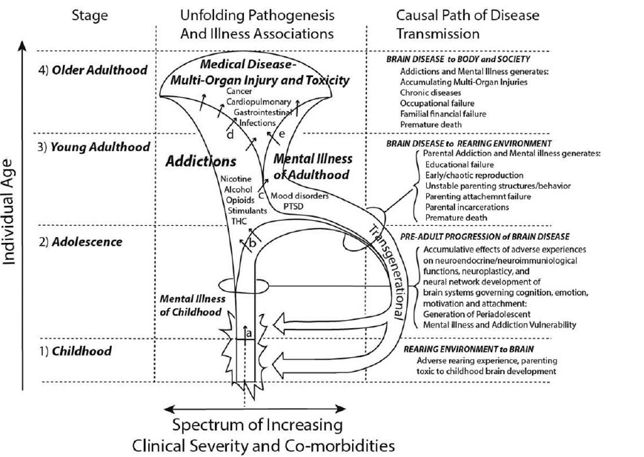
Zarse, E. M., Neff, M. R., Yoder, R., Hulvershorn, L., Chambers, J. E., & Chambers, R. A. (2019). The adverse childhood experiences questionnaire: two decades of research on childhood trauma as a primary cause of adult mental illness, addiction, and medical diseases. Cogent Medicine, 6(1), 1581447.
Notes:
A high degree of ACE associated with obesity/autoimmune disease/chronic obstructive pulmonary disease/ cardiovascular disease/ cancer
A high degree of ACE associated with aggression, victimhood, and perpetration/ suicide /pain /insomnia
A high degree of ACE associated with depression and PTSD
Prevention important
Treatment of people at various stages – perhaps stage 3 particularly important to prevent transgenerational effects

Slide 24
Nature of recommended interventions
Cognitive behavioural therapies for relapse prevention
  one 60-minute session per week for 12 weeks.
Behavioural therapies
  one 60-minute session per week for 12 weeks.
Social network and environment-based therapies
  eight 50-minute sessions over 12 weeks.
Behavioural couples therapy
  One 60-minute session per week for 12 weeks
These are resource intensive treatments and usually not available routinely in clinical practice
National Institute for Health and Care Excellence. (2011). Alcohol use disorders: diagnosis, assessment and management of harmful drinking and alcohol dependence CG115. London: National Institute for Health and Care Excellence.
Notes:
Behavioural therapies
– Cue exposure
– BSCT behavioural self control training
– contingency management
– aversion therapy

Slide 25
Clinical Guidelines
In addition to the evidence based psychological treatments (CM, BCT, MI), substance misuse services should provide psychosocial interventions, focusing on:
  Therapeutic alliance
  Structure and goal direction
  Opportunities to use rewards and rewarding activities
  Engagement in positive social networks
Interventions will vary depending on ‘Stage of Change’ and level of need
Clinical Guidelines on Drug Misuse and Dependence Update 2017 Independent Expert Working Group (2017). Drug misuse and dependence: UK guidelines on clinical management. London: Department of Health.

Slide 26







Stages of Change
(Prochaska & DiClemente,1983)
Maintenance
Relapse
Pre-contemplation
Contemplation
Preparation
Action

Slide 27
Clinical Guidelines (cont.)
Use of node-link mapping to deliver psychosocial interventions (see later)
Use of groups to deliver psychosocial interventions e.g. preparation for detox, relapse prevention
Assertively linking service users to recovery communities through ‘mutual aid’ groups
  12 step: Alcoholics/Narcotics/Cocaine Anonymous
  SMART Recovery: skills approach for cravings etc
  Moderation Management: non-abstinence approach

Slide 28
Motivational Interviewing (MI)
Developed by psychologists Bill Miller & Steve Rollnick
Motivational interviewing is a collaborative conversational style for strengthening a person’s own motivation and commitment to change
Can be effectively integrated into other interventions (e.g. brief interventions, results feedback, managing resistance, etc).
Miller, W. R., & Rollnick, S. (2012). Motivational interviewing : helping people change (3rd ed.). New York, NY: Guilford Press.

Slide 29
MI - Concepts
Ambivalence – key focus of MI
  Attachment to a given behaviour makes it difficult to move away from even if it causes problems
  Conflicting emotion about a behaviour is a ‘normal step on the road to change’
Righting reflex – the desire of the helper to want to ‘fix’ what seems wrong with people e.g. giving advice (unhelpful when someone is ambivalent)
Change talk – person’s own statements that favour change
Sustain talk – person’s own statements that favour status quo
Notes:
Righting reflex need to do something e.g., say “stop”

Slide 30
MI - Spirit
Partnership
Acceptance
  Absolute Worth/ Accurate Empathy/Autonomy/ Affirmation
Compassion
Evocation
Notes:
Spirit
Partnership – not expert to passive recipient
Acceptance
Do not accept status quo instead use the following domains
Absolute worth
Accurate empathy – not sympathy /”pity”; not identification “ been there”; instead understand frame of reference
Autonomy support
Affirmation – acknowledge strengths and weaknesses
Compassion – promote welfare
Evocation
Not a deficit model rather person has what they need and with therapist will find it – based on experience that once ambivalence resolved people address their misuse

Slide 31
MI - Process
Engaging
Focusing
  client has an agenda and the therapist has an agenda
Evoking
Planning
  When and How to change rather than whether or why
Notes:
4 processes
Engaging
Both parties establish a helpful connection and working relationship
Focusing –
client has an agenda and the therapist has an agenda – this is process is to maintain a specific direction in the conversation about change
Evoking
eliciting client’s own motivation for change
Planning –
threshold of readiness - when and how to change rather than whether or why

Slide 32
MI - Methods
Open ended questions
Affirmations
  E.g. ‘You’re clearly a resourceful person’
Reflections
  Simple - repeat what is said
  Complex
    Client: “I want to stop eating so much junk food; I must eat more fruit and veg”
    Therapist: “It sounds like you are worried about your health”
Summaries

Slide 33
MI - Principles
Roll with resistance - discussed later
Express empathy – can be tricky
  Therapist : “I know”
  Client: “You don’t know”
Develop discrepancy
  Therapist could highlight how a person may value appearance yet still inject
Support Self efficacy

Slide 34
MI - Resistance
Resistance is redefined as two factors:
  Sustain talk - arguing for status quo
  Discord - “Not being on the same wavelength” with the counsellor
Tools to manage Sustain Talk:
  Reflection/ Amplified reflection /Double sided reflection /Emphasize autonomy/ Reframing/Agreement with a twist/ Running head start
Notes:
Resistance
Responding to sustain talk and discord
Resistance was “ client moving away from change”
Resistance now viewed as composition of sustain talk (Ambivalence composed of change talk and sustain talk) and discord
Discord
“Talking at cross purposes”
“Disturbances in the relationship”
Running head start
Ask them all reasons for status quo then work out problems

Slide 35
MI - Discord
Client – indicators of discord:
    “Defending” /“Squaring off”/ “Interrupting” /“Disengagement”- “Distracted”
Interviewer Factors
  Tired/ distracted/very worried about the client/impatient
Tools to manage discord:
  Reflection / Affirming /Shifting focus /Apologizing
Notes:
Discord
Client - Smoke alarms
“Defending “- not my fault “
“Squaring off” – “you don’t care”; “what do you know”
“Interrupting” -“you are not hearing me”
“Disengagement”- “distracted”
Interviewer Factors
Tired/ distracted/very worried about the client/impatient
Discord at various stages
Engaging
Angry at the door
Focusing –
Therapist pushing their agenda too soon
Evoking
Moving too soon from whether to how
Planning –
Therapist moves away from autonomy of patient – takes over
Tools for discord
Reflection
Affirming
Shifting focus
Apologizing - therapist acknowledges own role in session not working out.

Slide 36
Various videos on motivational interviewing on internet
http://www.youtube.com/watch?v=dm-rJJPCuTE&list=PL0C3D4CCB642157AE
Wrong way and Right way
http://www.youtube.com/watch?v=80XyNE89eCs
http://www.youtube.com/watch?v=URiKA7CKtfc

Slide 37
Motivational Interviewing
Lundahl et al (2010) evaluated 132 implementations of motivational interviewing, most with substance use outcomes.
Motivational Interventions significantly outperformed when compared with treatment as usual, being handed written materials, being placed on a waiting list, or offered no treatment at all.
Lundahl, B. W., Kunz, C., Brownell, C., Tollefson, D., & Burke, B. L. (2010). A meta-analysis of motivational interviewing: Twenty-five years of empirical studies. Research on social work practice, 20(2), 137-160.
Notes:
Judged against weak comparison groups, MI produced statistically significant, durable results in the small effect range (average g = 0.28). Judged against specific treatments, MI produced nonsignificant results (average g = 0.09).

Slide 38
Is MI as effective as other structured interventions?
YES. Motivational interventions are roughly equivalent when compared with specific interventions such as CBT
But MI takes about 100 fewer minutes to have same effect.
Are the effects durable?
YES. Benefits of MI showed no signs of fading up to two years or more after intervention.
Does MI work in group formats?
NO. Limited data on group-delivered MI, but researchers interpretation is that “relying solely on group-delivered MI would be a mistake”
Lundahl, B. W., Kunz, C., Brownell, C., Tollefson, D., & Burke, B. L. (2010). A meta-analysis of motivational interviewing: Twenty-five years of empirical studies. Research on social work practice, 20(2), 137-160.

Slide 39
International Treatment Effectiveness Project ( 2007)
Provided principles of mapping currently used in GMMH substance misuse services
Collaboration btw National Treatment Agency, Texas Christian University and UK Providers
Aim was to improve treatment effectiveness
  Make the delivery of psychosocial interventions both easier and clearer
  Promote organisational improvements.
Built around a manual to make the intervention work
Campbell, A., Finch, E., Brotchie, J., & Davis, P. (2007). The International Treatment Effectiveness Project Implementing psychosocial interventions for adult drug misusers.
Simpson, D. D. (2005). An integrated approach to treatment for addiction. Texas: Institute of Behavioural Research at the Texas Christian University.

Slide 40
ITEP promoted ‘node-link mapping’
A cognitive approach for discussing issues with clients
Visualised issues in a series of ‘maps’
Used the same cognitive behavioural principles as motivational interviewing and relapse prevention
Reduced sessions to a record of decisions and progress

Slide 41
ITEP – ‘node-link mapping’
Formed a model for ‘cause-and-effect’ thinking + problem-solving which clients could use
Interventions used aimed at changing thinking patterns
E.g., address thought-processes that could hamper behavioural change
Maps were used as a way of creating a visual ‘hook’ for the discussion

Slide 42
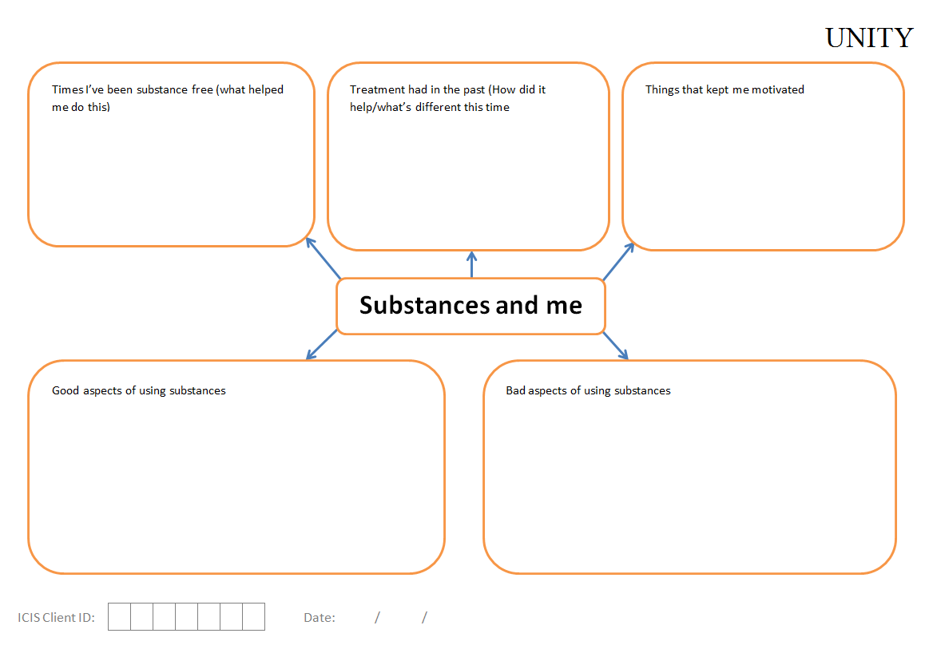
Example of a Map used

Slide 43
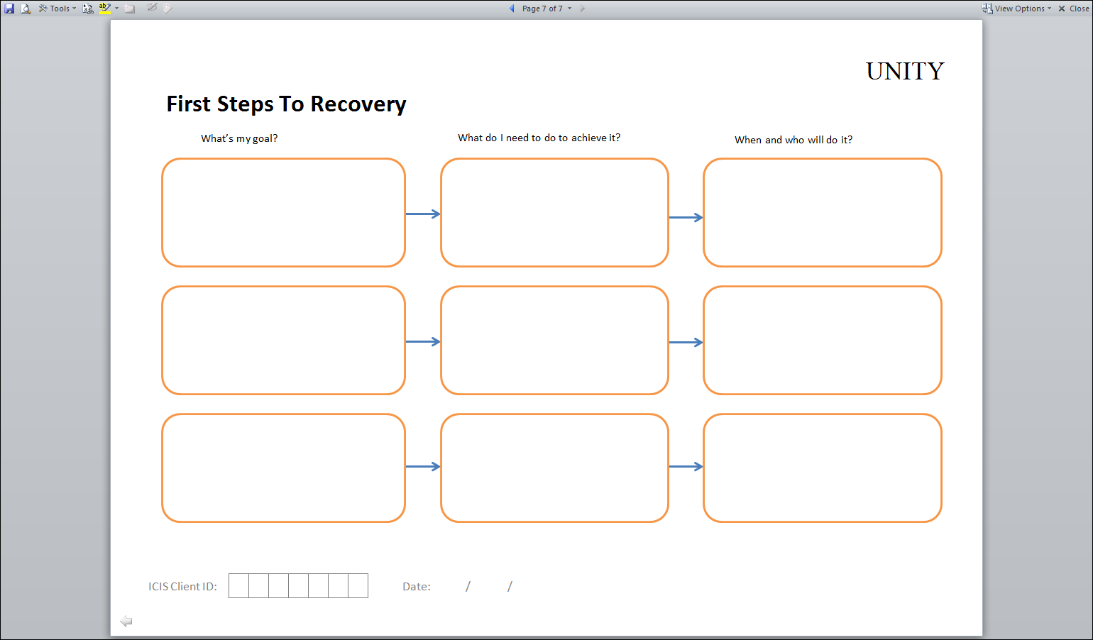
Example of a Map used

Slide 44
Benefits of Maps

Slide 45
Node mapping evaluated in a number of trials
Comparison of clients assigned to "node-link mapping" or "standard"
  Mapping clients had significantly fewer opiate-positive urine samples during months 2-6 of treatment
  Greater Coverage of collateral issues by counsellors
  Clients reported less criminal activity after 12 months
Dees, S. M., Dansereau, D. F., & Simpson, D. D. (1997). Mapping-enhanced drug abuse counseling: Urinalysis results in the first year of methadone treatment. Journal of Substance Abuse Treatment, 14(1), 45-54.
Pitre, Joe, G. W., Dansereau, D. F., Pitre, U., & Simpson, D. D. (1997). Effectiveness of node-link mapping enhanced counseling for opiate addicts: A 12-month posttreatment follow-up. The Journal of nervous and mental disease, 185(5), 306-313.
Joe, G. W., Dansereau, D. F., Pitre, U., & Simpson, D. D. (1997). Effectiveness of node-link mapping enhanced counseling for opiate addicts: A 12-month posttreatment follow-up. The Journal of nervous and mental disease, 185(5), 306-313.
Notes:
J Subst Abuse Treat. 1997 Jan-Feb;14(1):45-54.
Mapping-enhanced drug abuse counseling: urinalysis results in the first year of methadone treatment.
Dees SM1, Dansereau DF, Simpson DD.
Author information
Abstract
Urinalysis (UA) tests for opiates and cocaine were obtained over a 12-month period for a total of 155 long-term clients who participated in treatment in one of three urban methadone centers. At admission, clients were randomly assigned to "node-link mapping" (n = 82) or "standard" (n = 73) counseling treatment. Node-link mapping is a strategy for visually representing interrelationships between clients' ideas, feelings, and experiences. These multirelational maps are developed (usually by counselors) during individual and group counseling sessions to clarify clients' issues and problems. The results revealed that (a) mapping clients had significantly fewer opiate-positive UAs during months 2-6 of treatment and (b) session attendance was a significant predictor of cocaine-positive UAs over months 2-12 for mapping clients.
J Addict Dis. 1997;16(3):39-49.
The role of node-link maps in enhancing counseling efficiency.
Pitre U1, Dansereau DF, Simpson DD.
Author information
Abstract
Node-link mapping is a counseling tool that helps clients and counselors visualize relationships between ideas, actions, and feelings. Previous research has shown that methadone-maintained clients receiving mapping-enhanced counseling have more positive during-treatment outcomes (e.g., better session attendance and higher probability of clean urines) than those receiving standard counseling. Findings also suggest that mapping enhances the efficiency of counseling sessions by increasing "on task" attention and by reducing communication problems. In this study, mapping counseling was associated with greater coverage of collateral issues (i.e., issues indirectly related to drug use) than standard counseling and lower during-treatment use as indicated by urinalysis results.
J Nerv Ment Dis. 1997 May;185(5):306-13.
Effectiveness of node-link mapping enhanced counseling for opiate addicts: a 12-month posttreatment follow-up.
Joe GW1, Dansereau DF, Pitre U, Simpson DD.
Author information
Abstract
Drug abuse counseling was enhanced by node-link mapping, a visual representation technique, and evaluated in a posttreatment follow-up study. Clients randomly assigned to receive mapping counseling reported less criminal activity 12 months after treatment than did clients in the standard counseling condition. It was also found that among clients staying less than 6 months in treatment, those in the mapping group had fewer urine samples that tested positive for opiates at follow-up. Thus, mapping-enhanced counseling may be especially beneficial for clients who leave treatment prematurely.

Slide 46
Expert led session
Psychological approaches in substance misuse problems
Review models of dependence
Review psychosocial treatments for people with substance misuse problems
Overview of various interventions that are offered in substance misuse: brief interventions, mapping techniques (e.g., ITEP), motivational interviewing overview

Slide 47
Substance Misuse
MCQs
1. Which of the following is not an example of change talk:
  A. Desire: I would like to stop using alcohol
  B. Ability: I could stop alcohol use
  C. Reason: Alcohol worsens my psoriasis
  D. Accomplishment: I finally stopped alcohol
  E. Need: I have got to stop alcohol

Slide 48
Substance Misuse
MCQs
1. Which of the following is not an example of change talk:
  A. Desire: I would like to stop using alcohol
  B. Ability: I could stop alcohol use
  C. Reason: Alcohol worsens my psoriasis
  D. Accomplishment: I finally stopped alcohol
  E. Need: I have got to stop alcohol

Slide 49
Substance Misuse
MCQs
2. Prochaska and DiClemente‟s stages of change include the following except:
  A. Contemplation
  B. Preparation
  C. Maintenance
  D. Relapse
  E. Persistence

Slide 50
Substance Misuse
MCQs
2. Prochaska and DiClemente‟s stages of change include the following except:
  A. Contemplation
  B. Preparation
  C. Maintenance
  D. Relapse
  E. Persistence

Slide 51
Substance Misuse
MCQs
3. Who of the following is most closely linked with Motivational Interviewing:
  A. Carl Jung
  B. Carl Rogers
  C. David Winnicott
  D. Aaron Beck
  E. Melanie Klein

Slide 52
Substance Misuse
MCQs
3. Who of the following is most closely linked with Motivational Interviewing:
  A. Carl Jung
  B. Carl Rogers
  C. David Winnicott
  D. Aaron Beck
  E. Melanie Klein

Slide 53
Substance Misuse
MCQs
4. All of the following are key principles of Motivational Interviewing except:
  A. Roll with resistance
  B. Express empathy
  C. Develop discrepancy
  D. Support self efficacy
  E. Strengthen safety behaviour

Slide 54
Substance Misuse
MCQs
4. All of the following are key principles of Motivational Interviewing except:
  A. Roll with resistance
  B. Express empathy
  C. Develop discrepancy
  D. Support self efficacy
  E. Strengthen safety behaviour

Slide 55
Substance Misuse
MCQs
5. Which of the following is true of needle exchange programmes in the UK
  Pharmacies are unable to provide this service
  It is only available to people prescribed opioid substitute medications
  C. It is only available in urban centres with populations greater than 50000
  D. Only qualified nursing staff can dispense equipment
  E. It reduces injection risk behaviours among people who inject drugs, in particular self- reported sharing of needles and syringes, and frequency of injection

Slide 56
Substance Misuse
MCQs
5. Which of the following is true of needle exchange programmes in the UK
  A. Pharmacies are unable to provide this service
  B. It is only available to people prescribed opioid substitute medications
  C. It is only available in urban centres with populations greater than 50000
  D. Only qualified nursing staff can dispense equipment
  E. It reduces injection risk behaviours among people who inject drugs, in particular self- reported sharing of needles and syringes, and frequency of injection

Slide 57
Substance Misuse
EMIs
Potential mechanisms to manage resistance:
A. Simple reflection
B. Amplified reflection
C. Double sided reflection
D. Shifting focus
E. Reframing
F. Agreement with a twist
G. Emphasising personal
control
H. Coming alongside
I. Reaction
J. Summarizing
1a. This approach enables the validity of the client’s raw observation to be regarded but tries to interpret the observation in a new way.
1b. This may be considered when someone says “I am my own man, I do not need you to tell me what to do”
1c. The following exchange highlights this approach:
Client:” I have been able to use more heroin than other people in my town”
Therapist: “Perhaps you are simply immune to the effects of heroin”.

Slide 58
Substance Misuse
EMIs
1a. This approach enables the validity of the client’s raw observation to be regarded but tries to interpret the observation in a new way. Answer: Reframing
1b. This may be considered when someone says “I am my own man, I do not need you to tell me what to do”. Answer: Emphasising personal control
1c. The following exchange highlights this approach:
Client:” I have been able to use more heroin than other people in my town”
Therapist: “Perhaps you are simply immune to the effects of heroin”.
Answer: Amplified reflection

Slide 59
Substance Misuse
EMIs
Mutual aid groups / Services:
A. Alcoholics Anonymous (AA)
B. SMART Recovery
C. GamCare
D. Frank
E. Teen Challenge UK
F. British Doctors‟ and Dentists' Group
G. Narcotics Anonymous (NA)
H. Breaking free
I. Kaleidoscope
J. Discover
2a. This is a global, community-based organization with a multi-lingual and multicultural membership. It was founded in 1953
2b. This is a science-based programme to help people manage their recovery from any type of addictive behaviour. It began in 1994.
2c. This is a free drug advice service that is aimed at parents and children in particular. It is available 24 hours a day and online and by text message

Slide 60
Substance Misuse
EMIs
Mutual aid groups/Services:
2a. Founded in 1997, This is one of the leading providers of information, advice and support for anyone affected by this pattern of disordered behaviour. Answer:Gamcare
2b. This is a science-based programme to help people manage their recovery from any type of addictive behaviour. It began in 1994. Answer:SMART Recovery
2c. This is a free drug advice service that is aimed at parents and children in particular. It is available 24 hours a day and online and by text message Frank

Slide 61
The following optional additional slides outline more addiction models.

Slide 62
Psychodynamic model
THE DEFENSIVE MOTIVE
Defence against intense affect (anxiety, anger, depression)
Problems in affect tolerance
Failure of internalization
Drugs - as the externalized “good mother”, source of comfort and security

Slide 63
Operant Conditioning
– types of contingencies
 | Appetitive | Aversive
Positive (an event produced) | Positive reinforcement (‘buzz’, rewarding aspects of drugs): increase in behaviour | Positive punishment (hangover, ill-health, etc): decrease in behaviour
Negative (an event is prevented) | Negative reinforcement (blocks out painful emotions, anxiety etc): increase in behaviour | Negative punishment (loss of jobs, relationship break ups etc): decrease in behaviour

Slide 64
Models of addiction: cognitive – behavioural – sociocultural models
Orford (2001) - Substance misuse conceptualised as an ‘excessive appetite’ belonging to the same class of disorders as gambling, eating disorders and sex addiction.
Orford argued that the emotional regulation of appetitive behaviours in their respective social contexts follows principles of operant conditioning.
Secondary factors, such as internal conflict, may impact on the extent of continued use or recovery.
Orford, J. (2001). Addiction as excessive appetite. Addiction, 96(1), 15-31.
Notes:
A core postulate of the excessive appetite model of how an addiction is generated is, therefore,
that a combination of operant reward, usually in the form of some powerful emotional change,
plus wide cue elicitation of conditioned responses that assist consumption in one way or
another, operating within diverse social contexts, between them constitute a powerful set of processes
responsible for the amplification of a small and unremarkable liking into a strong and potentially
troublesome attachment.
An additional step in some models posit a combination of learning and memory elements into ‘cognitive schemata’.
e.g., Leventhal & Cleary’s (1980) ‘multiple regulation model’
In their view, emotional regulation was the key to smoking, but that several emotional processes might operate
simultaneously. Smokers formed a strong emotional memory of this complex action of smoking. It was this ‘memory schema’ that was responsible for provoking desire or, as they called it, ‘craving’.
Orford’s Proposal is that the mechanisms outlined above are at the core of addiction that there are additional processes involved.
These are ‘secondary’ processes in distinction to the ‘primary’ conditioning, learning and cognitive processes described earlier.
One type is acquired emotional regulation cycles.
It is supposed that the stronger an attachment becomes the more likely it is that these new processes will ‘kick in’, providing further incentive for consumption by serving new emotional regulating functions.
An example, is the so-called abstinence violation effect (AVE).
The AVE includes feelings of guilt and self-blame, self-attributions that are internal, global and uncontrollable,
and feelings of helplessness and hopelessness.
The second type of additional, amplifying processes may be thought of as the consequences of
conflict. The development of a strong appetite alters in a fundamental way the balance that has
to be struck between inclination and restraint.
Continued commitment to a form of behaviour which is harmful or troublesome calls for dissonance
reduction in the interests of consistency
Leventhal, H., & Cleary, P. D. (1980). The smoking problem: a review of the research and theory in behavioral risk modification. Psychological bulletin, 88(2), 370.

Slide 65
Attachment
From Bowlby’s work with children and care givers
Combines biological component and learned styles of care giving
Attachment is dependant on a match between the needs of the infant and the care giver - pathology = mismatch
Defined as healthy and unhealthy attachment (anxious-avoidant ; ambivalent; disorganized )
Linked to developmental psychology, mentalisation (theory of mind) and interactional psychologies i.e. as adults we replicate early relationships

Slide 66
Attachment Model of Addiction (Flores, 2004)
Addictus (Latin)---attached or enslaved to something
As long as the person continues to use substances it will be difficult to establish good therapeutic relationships
Model is consistent with 12 Steps and Psychoanalytic approaches
Flores, P. J. (2004). Addiction as an attachment disorder. Jason Aronson.
Notes:
False pride inflated ego and grandiosity are defences against feelings of inferiority and inadequacy p81
The treatment of narcissism has many similarities to and applications for the treatment of addiction. p83
Addiction as an attachment disorder

Slide 67
Recovery as reversing
‘narcissistic’ defences (Flores, 2004)
Addiction
“I don’t need other people”
“I don’t have a problem with alcohol or drugs”
“I am addicted to alcohol or drugs”
“I need other people”
Recovery

Slide 68
Conditions that promote addiction (West, 2007)
A culture in which the activity is commonplace and regarded as normal
Peer groups in which the activity forms a part of social Identity
An environment with greater opportunities to engage in the activity
An environment with reduced opportunities for other sources of reward
Adverse social, economic or environmental circumstances
Possibly an environment in which there is lower propensity for the activity to lead to immediate adverse consequences
West, R. (2007). The PRIME Theory of motivation as a possible foundation for addiction treatment. John’s Hopkins University Press
http://www.primetheory.com/
Notes:
Social and physical conditions that are not conducive to motivational balance by virtue of providing opportunities or incentives for a behaviour and/or failing to provide motivation for restraint

