Slide 1

Substance Misuse Module
Diagnosis and Treatment of People with Drug Misuse

Slide 2
Aims and Objectives (from handbook)
Assessment, diagnosis and treatment of people with drug misuse
To develop working knowledge of principles of opioid substitution treatment
To increase awareness of other substances commonly misused
To develop awareness of complications associated with drug misuse

Slide 3
To achieve this
Case Presentation
Journal Club
555 Presentation
Expert-Led Session
MCQs
Please sign the register and complete the feedback

Slide 4
Expert Led Session
Diagnosis and treatment of people with problems with opioid dependence
P Horgan
Consultant in Substance Misuse, Cumbria

Slide 5
Structure
Epidemiology /Context
Opioid related mortality morbidity
Assessment
Treatment with opioid replacement treatment
Detoxification
Risks with opioid replacement treatment

Slide 6
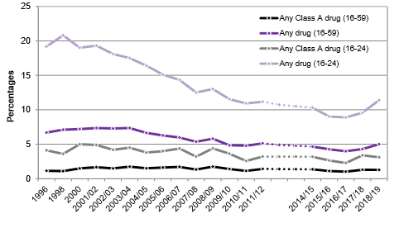
Trends in drug use in the last month among adults, 16 to 59 and 16 to 24 year old, 1996 to 2018/19 CSEW
Drug Misuse: Findings from the 2018/19 Crime Survey for England and Wales
Notes:
The number of adults aged 16 to 59 who had taken drugs in the last month has decreased over the lifetime of the survey. The 2018/19 CSEW showed the following trends in last month drug use:
Around 1 in 20 adults (5.0%) aged 16 to 59 said they had taken a drug in the last month, equating to around 1.7 million people. Since the series began there has been a general decline in last month drug use among this age group (6.7% in 1996), although the latest estimate was higher compared with last year (2017/18, 4.3%)
The proportion among young adults aged 16 to 24 followed a similar trend, although the estimate of drug use in the last month in the 2018/19 CSEW was more than double that of the wider age group (11.4%), which equates to around 724,000 young people having taken a drug in the month prior to interview. There was a decline in the proportion of last month users from the peak in 1998 (20.8%) to 8.9 per cent in 2016/17. Since the 2016/17 survey there have been small but non-significant increases, in the proportion who used a drug in the last month

Slide 7
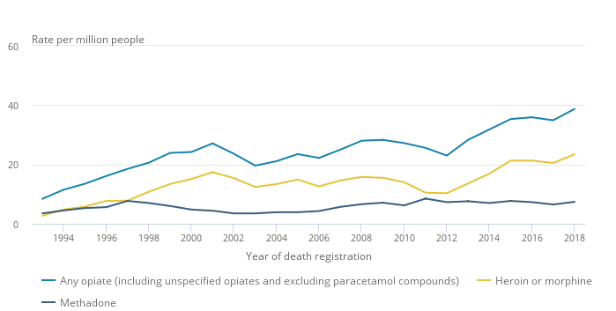
Age standardised Mortality rates for deaths by all opiates, heroin or morphine, and methadone
Deaths related to drug poisoning in England and Wales: 2018 registrations
Notes:
Two-thirds (or 2,917) of drug-related deaths were related to drug misuse, accounting for 50.9 deaths per million people in 2018
The number of deaths registered from drug use in 2018 was the highest since our records began in 1993. We have also seen the biggest year-on-year percentage increase".
Between 2017 and 2018, there were increases in the number of deaths involving a wide range of substances, though opiates, such as heroin and morphine, continued to be the most frequently mentioned type of drug.

Slide 8
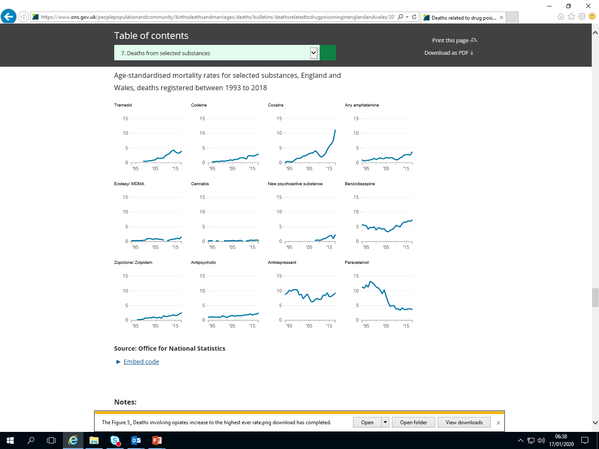
Age-standardised mortality rates for selected substances England and Wales
Notes:
Deaths registered between 1993 to 2018
Deaths involving cocaine doubled between 2015 and 2018 to their highest ever level, while the numbers involving new psychoactive substances (NPS) returned to their previous levels after halving in 2017

Slide 9
Age-standardised mortality rates for selected substances England and Wales
Notes:
Deaths registered between 1993 to 2018
Concern in particular about Quetiapine
Out of the 2593 drug misuse deaths (2017 report)
benzodiazepines were mentioned on 406 death certificates
antidepressants were mentioned on 460 death certificates
antipsychotics were mentioned on 114 death certificates

Slide 10
SMR in people with opioid dependence in NSW 1985–2006
Causes of death | SMR | CI
Total mortality | 6.5 | (6.3–6.7)
All drug-related | 35 | (33.4–36.6)
Accidental drug-related | 39.9 | (38.0–41.8)
Accidental opioid-related | 42.8 | (40.7–45.0)
Accidental other drug-related | 24.1 | (20.6–28.1)
Unintentional injuries | 9.6 | (9.0–10.2)
Motor vehicle accidents | 3.2 | (2.7–3.7)
Violence | 7.6 | (6.1–9.5)
Suicide | 6.2 | (5.6–6.7)
Causes of death | SMR | CI
All liver-related | 11.4 | (10.1–12.9)
Chronic liver disease | 6.5 | (5.3–8.0)
Viral hepatitis | 46.3 | (38.5–55.2)
Cardiovascular | 2.1 | (1.9–2.5)
Cancer | 1.7 | (1.4–1.9)
HIV AIDS | 4.4 | (3.5–5.3)
Alcohol-related | 5.4 | (4.4–6.6)
Chronic respiratory disease | 3.9 | (2.7–5.5)
Respiratory infections | 7.9 | (5.1–11.8)
Degenhardt, L., Larney, S., Randall, D., Burns, L., & Hall, W. (2014). Causes of death in a cohort treated for opioid dependence between 1985 and 2005. Addiction, 109(1), 90-99.

Slide 11
Hepatitis C
In England, 160,000 adults are estimated to be chronically infected with hepatitis C
Injecting drug use continues to be the most important risk factor for HCV infection
In 2015 for England, 52% of PWID tested positive for antibodies to HCV (anti-HCV)
Target of 2030 to eliminate hepatitis C as a public health concern
Costella, A., Harris, H., Mandal, S., & Ramsay, M. (2017). Hepatitis C in England: 2017 report.
Notes:
In 2005, an estimated 160,000 people in England were thought to be living with chronic HCV infection, and injecting drug use continues to be the most important risk factor for HCV infection. In 2015, 52% of people who had injected psychoactive drugs, participating in the Unlinked Anonymous Monitoring (UAM) Survey of people who inject drugs (PWID), tested positive for antibodies to HCV (anti-HCV), and this proportion has remained relatively stable over the past decade.
Injecting drug use continues to be the most important risk factor for HCV infection, being cited as the risk in approximately 90% of all laboratory reports where risk factors have been disclosed.

Slide 12
Deaths from ESLD or HCC in those with HCV mentioned on their death certificate in England: 2005-2015

Slide 13
History
Current Reported Substance Use (assess for most recent use)
  Illicit Methadone Mix /Illicit Buprenorphine /Heroin /Crack /Benzodiazepines /Cocaine powder /Amphetamine/Cannabis /Plant food/Spice/Pregabalin/ Gabapentin /Alcohol / Cigarettes
Withdrawals
  Sweating /Agitation present
Previous Treatment
  Buprenorphine/ methadone/ MXL/Injectable + Significant periods of abstinence + Factors helped/not helped with abstinence
Accidental overdoses
  Most recent / naloxone used/ admission needed
Screens
  Drug Screen – Opiates / Methadone / Buprenorphine / Cocaine / Amphetamine / Benzos
  Breath Alcohol reading
Medication
  Prescribed by Drug and Alcohol service /Naloxone last issued ( Prenoxad/ Ampoules/Nyxoid) /Medication Prescribed by GP/other /Over the counter use/ herbal medications

Slide 14
History
Physical health
  Hepatitis /BBV
  Breathlessness
  Injecting related illness
    DVT/PE/Endocarditis/ulcers/cellulitis
General
  Any admissions (planned or unplanned) to hospital within the last 12 months
Mental Health
  Depression/Anxiety/Psychosis/Bipolar Affective disorder/ Personality disorder/DSH/Suicide
Social Issues
  Homelessness/ family support
Risks / Forensic
  Driving/Children/Safe Storage/Criminal Justice system/Violence /County Lines

Slide 15
Investigations
COWS ( Clinical opiate withdrawal scale)
  11 items (score ranges 0 to 48)
    5-12 Mild
    13-24 Moderate
    25-36 Moderately severe
    More than 36 Severe withdrawals
.
Notes:
7 items scored up of 4 and 4 items scored up of 5

Slide 16
Investigations
Guided by clinical presentation – e.g., Local infection, Sepsis, Hemorrhage, DVTs, PE
Some screening bloods may indicate the following
Full blood count
  High white cell count
    Undisclosed abscess e.g., from injecting into femoral vein; consider subacute endocarditis
    CRP may also be elevated
Liver function tests
  High ALT could be related to hepatitis C
Hepatitis B/ Hepatitis C /HIV screening
HbA1c (e.g., important factor for venous leg ulcers; drowsiness attributed to drugs)
ECG (within past 12 months if at risk for QTc Prolongation )
Spirometry if clinically indicated
Pregnancy tests.
Notes:
AST and ALT are enzymes present in hepatocytes and are released into the blood stream in response to hepatocyte injury or death (hepatitis).
ALT more liver specific than AST

Slide 17
Examination
Breath alcohol reading recording
PR, BP, Temperature, Oxygen saturation
Full Physical examination
Mental state examination – could be affected by drug use

Slide 18
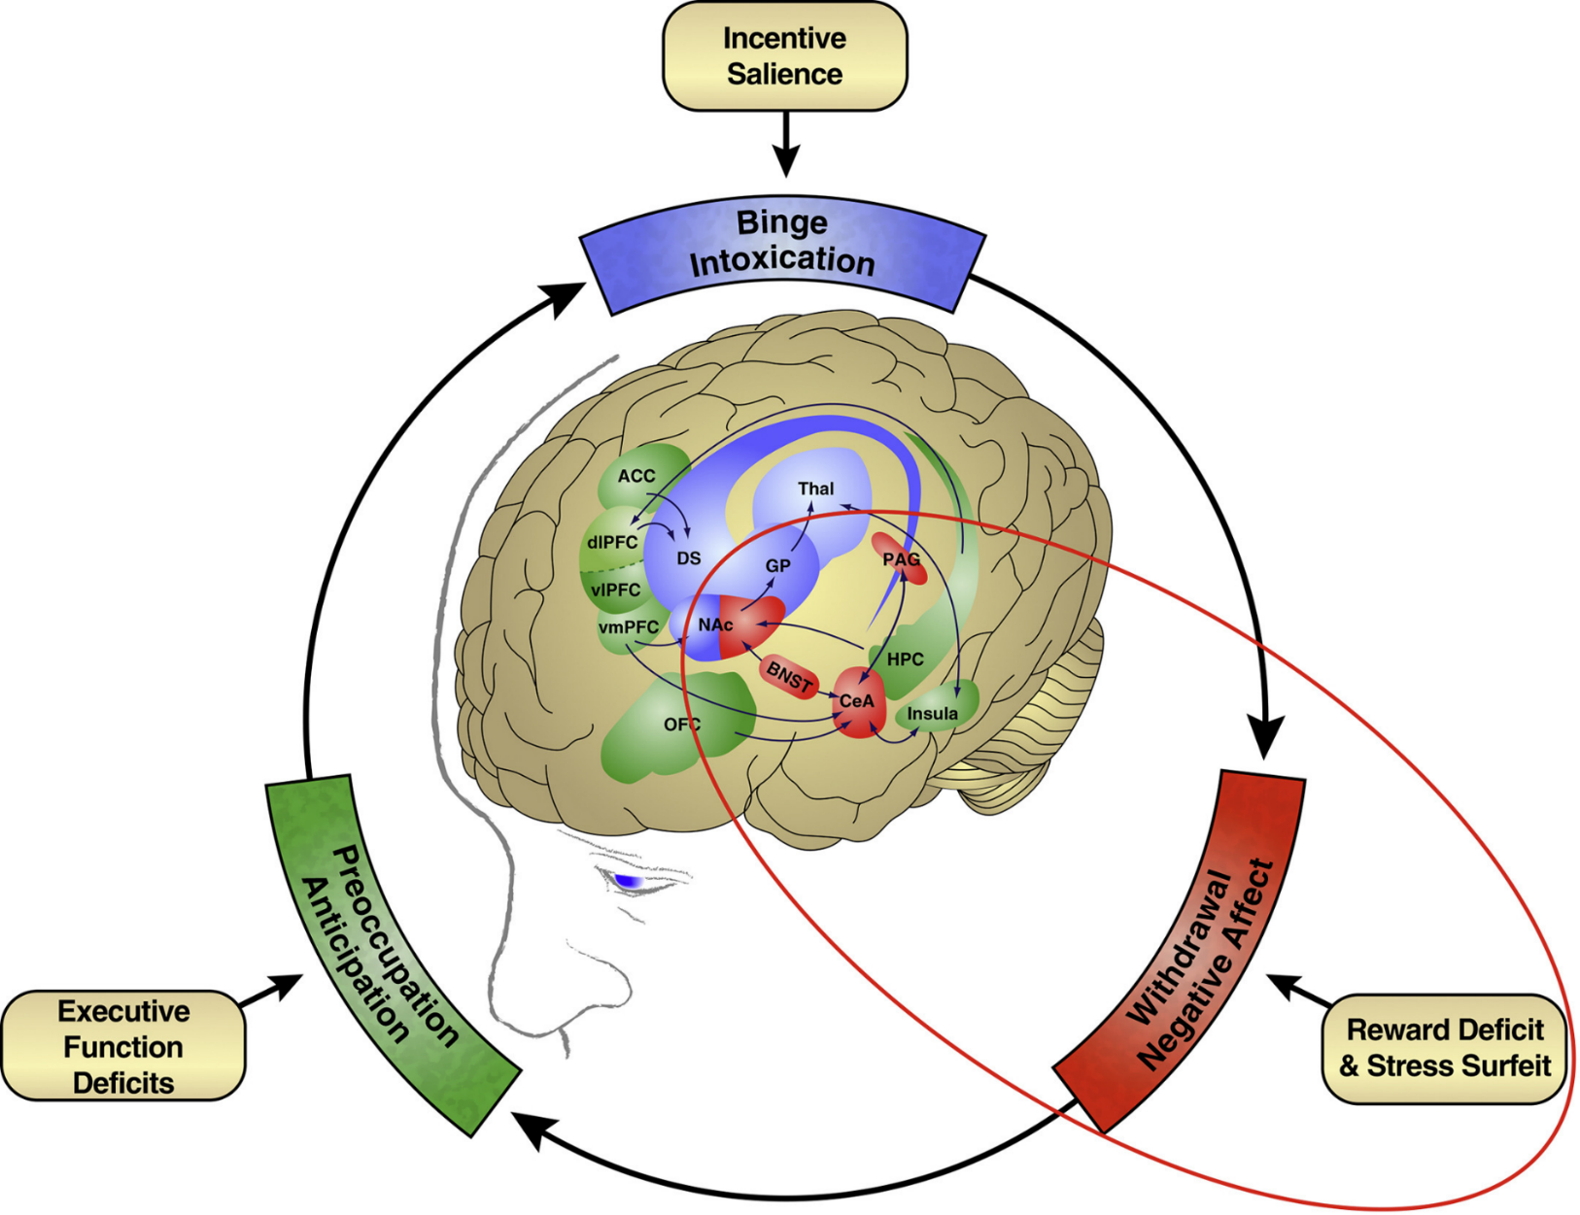
3-stage cycle -binge/intoxication, withdrawal/negative affect, preoccupation/anticipation
Dysregulation- incentive salience/habits, negative emotional states, executive function
Related to basal ganglia, extended amygdala, and prefrontal cortex
Koob, G. F. (2020). Neurobiology of opioid addiction: Opponent process, hyperkatifeia, and negative reinforcement. Biological psychiatry, 87(1), 44-53.
Notes:
ACC, anterior cingulate cortex;
BNST, bed nucleus of the stria terminalis;
CeA, central nucleus of the amygdala;
DS,dorsal striatum;
dlPFC, dorsolateral prefrontal cortex;
GP, globus pallidus;
HPC, hippocampus;
NAC, nucleus accumbens;
OFC, orbitofrontal cortex;
PAG, periaqueductal gray;
Thal, thalamus;
vlPFC, ventrolateral prefrontal cortex;
vmPFC, ventromedial prefrontal cortex.
Koob, G. F. (2020). Neurobiology of opioid addiction: Opponent process, hyperkatifeia, and negative reinforcement. Biological psychiatry, 87(1), 44-53.
Introduction
“A heuristic framework for opioid addiction consists of a 3-stage cycle—binge/intoxication, withdrawal/negative affect,
and preoccupation/anticipation—that represents dysregulation in 3 functional domains (incentive salience and/or habits,
negative emotional states, and executive function, respectively)and is mediated by 3 major neurocircuitry elements
(basal ganglia, extended amygdala, and prefrontal cortex, respectively).
Opioids are a classic drug of addiction, in which an evolving pattern of use includes intense initial intoxication
that is associated with intravenous or smoked drug taking, the development of profound tolerance, and the consequent
escalation of intake. Abstinence results in profound dysphoria, physical discomfort, and somatic signs of withdrawal. Intense
preoccupation with obtaining opioids (craving) then develops, often preceding somatic signs of withdrawal. This craving is
linked to stimuli that are associated with obtaining the drug and stimuli that are associated with withdrawal and internal
and external states of stress. A pattern develops in which the drug must be administered to avoid the severe dysphoria and
discomfort of abstinence. Thus, opioid addiction can be defined as a compulsion to seek and take a drug, a loss of
control in limiting intake, and the emergence of a negative emotional state when access to the drug is prevented.”

Slide 19
Treatment of opioid dependence
The needs of all drug misusers should be assessed across four domains; drug and alcohol misuse, health, social functioning and criminal involvement.
Risks to dependent children should be assessed
All drug misusers entering structured treatment should consent to their treatment plan which is regularly reviewed.
A named individual should manage the care plan
Drug testing can be a useful tool in assessment diagnosis and monitoring
Drug misuse treatment involves a range of interventions, not just prescribing.
Clinical Guidelines on Drug Misuse and Dependence Update 2017 Independent Expert Working Group (2017). Drug misuse and dependence: UK guidelines on clinical management. London: Department of Health

Slide 20
Pharmacological components
Methadone or buprenorphine are effective medicines for heroin dependence especially at optimal dose
Dose induction with buprenorphine may be carried out more rapidly with less risk of overdose
Care with children
Supervised consumption should be available
Methadone and buprenorphine are effective in detoxification regimens
Clinical Guidelines on Drug Misuse and Dependence Update 2017 Independent Expert Working Group (2017). Drug misuse and dependence: UK guidelines on clinical management. London: Department of Health

Slide 21
Opioid substitution treatment
(OST) effectiveness
The evidence is good that OST
  Reduces the risk of death among heroin users participating in treatment
  Suppresses illicit use of heroin
  Prevents people dropping out of treatment
  Reduces involvement in crime among heroin users participating in treatment
  Reduces the risk of BBV transmission, including in prisons
Strang, J. (2012). Medications in recovery: re-orientating drug dependence treatment. National Treatment Agency, London.
Notes:
21

Slide 22
Opioid substitution treatment
(OST) effectiveness
Evidence is less good that OST
  Suppresses other drug use
  Promotes abstinence from all drugs
  Improves physical and mental health –the evidence suggests rapid and substantial improvements on treatment entry, but may not be maintained or further improved
  Improves social reintegration of marginalised heroin users
Strang, J. (2012). Medications in recovery: re-orientating drug dependence treatment. National Treatment Agency, London.
Notes:
22

Slide 23
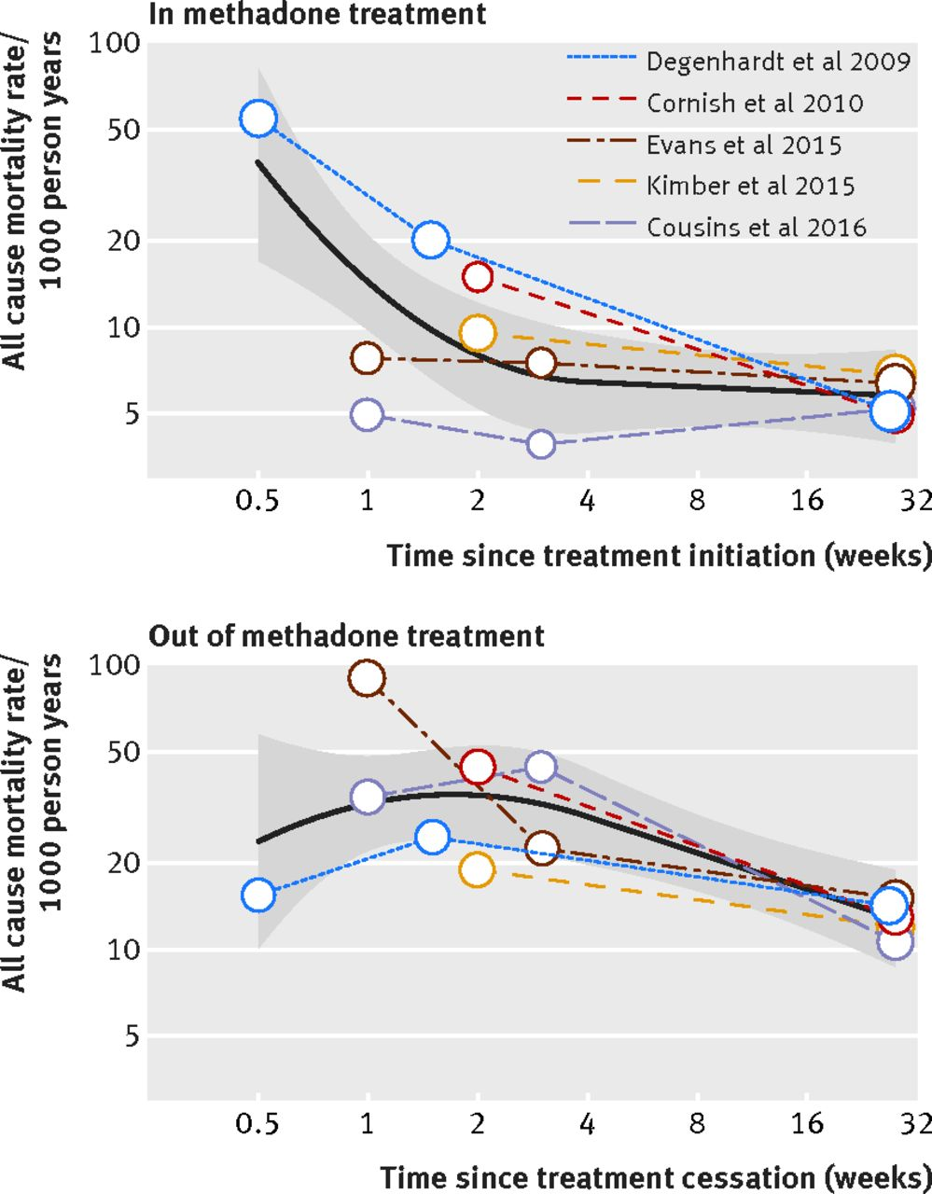
Risks periods in and out of treatment with Methadone
Pooled trends in all cause mortality risk (solid lines) and their 95% confidence intervals (shaded regions) over time in and out of methadone treatment
Higher risk in first 4 weeks in treatment
Suggestion less of a problem with buprenorphine
Sordo, L., Barrio, G., Bravo, M. J., Indave, B. I., Degenhardt, L., Wiessing, L., ... & Pastor-Barriuso, R. (2017). Mortality risk during and after opioid substitution treatment: systematic review and meta-analysis of cohort studies. bmj, 357.
Notes:
The pooled all cause mortality rates decreased from 37.4 to 6.4 deaths per 1000 person years during the initial four weeks of methadone treatment and were fairly stable thereafter. In contrast, after people left methadone treatment, the pooled all cause mortality remained high at between 24.1 and 35.2 deaths per 1000 person years during the initial two weeks out of treatment and decreased progressively afterwards.

Slide 24
How long to continue treatment?
Increased length of time in OST associated with improved outcomes
Short-term treatment associated with poorer outcomes
Study on people on methadone treatment over 30 year period demonstrated that 40% with stable remission spent between five to eight years in OST
English government has used findings that heroin users need at least 12 weeks in OST for benefit to underpin policy on treatment
Some USA authors suggest a 1 year minimum time on OST
Advisory Council on the Misuse of Drugs. Time limiting opioid substitution therapy advice. 6 Nov 2014. https://www.gov.uk/government/publications/time-limiting-opioid-substitution-therapy.
Notes:
There is international research evidence that increased length of time in OST is associated with improved treatment outcomes (including reduced use of other opioids and reduced criminal activity) and short-term methadone maintenance treatment is associated with poorer outcomes. Similarly USA research indicates that a longer time in OST is significantly associated with favourable outcomes. A study following people on from a methadone programme over 30 years showed that the 40% who had achieved stable remission had spent between five to eight years in OST.
The English government national target on retention in drug treatment was based on evidence that heroin users required at least 12 weeks in OST to derive any lasting benefit from that treatment. Some USA authors are stating that the minimum time to achieve benefit from an OST maintenance program is one year as longer retention in OST (up to one year or more) consistently shows better – and better sustained – post treatment outcomes.
This doesn’t really reflect current situation.

Slide 25
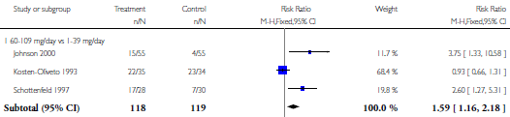
Comparison 1 RCT, Outcome 6 Opioid abstinence at >3-4 weeks (urine based).
Faggiano, F., Vigna‐Taglianti, F., Versino, E., & Lemma, P. (2003). Methadone maintenance at different dosages for opioid dependence. Cochrane Database of Systematic Reviews, (3).
Notes:
Higher doses of methadone favours outcome

Slide 26
MMT vs No MMT
Morphine positive urine or hair analysis.
Mattick, R. P., Breen, C., Kimber, J., & Davoli, M. (2009). Methadone maintenance therapy versus no opioid replacement therapy for opioid dependence. Cochrane database of systematic reviews, (3).
Notes:
Clear effect

Slide 27
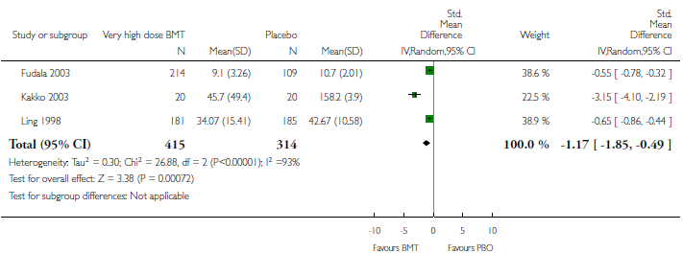
High-dose buprenorphine versus placebo - morphine-positive urines
Notes:
High fixed dose favours outcome

Slide 28
Opioid pharmacology
Mu | Delta | Kappa
Mu 1 – Analgesia Mu 2 – Sedation, vomiting, respiratory depression, pruritus, euphoria, anorexia, urinary retention, physical dependence | Analgesia, spinal analgesia | Analgesia, sedation, dyspnea, psychomimetic effects, miosis, respiratory depression, euphoria, dysphoria, dyspnoea
Notes:
Sigma (σ) (agonist N-allylnormetazocine) Sigma receptors are responsible for psychomimetic effects, dysphoria, and stress-induced depression. They are no longer considered opioid receptors, but rather the target sites for phencyclidine (PCP) and its analogs.

Slide 29
Actions of opioids
Drug | Mu | Delta | Kappa
Morphine | Agonist |  | Weak agonist
Codeine | Weak agonist | Weak agonist
Fentanyl | Agonist
Methadone | Agonist
Buprenorphine | Partial agonist |  | Partial agonist

Slide 30
Pharmacokinetics - methadone
Well absorbed from the gastrointestinal tract with peak plasma levels occurring 1-5 hours after a single dose.
Wide variations in plasma levels occur during maintenance therapy.
Plasma levels may decrease due to auto-induction of hepatic microsomal enzymes.
Gradual accumulation in tissues
On discontinuation, low concentrations in the plasma are maintained by slow release from extravascular binding sites accounting for the relatively mild but protracted withdrawal syndrome.
N-demethylation occurs in the liver and metabolites are excreted in the faeces and urine together with unchanged methadone
The elimination half-life is long and varies considerably with a range of 15-60 hours having been reported
https://www.medicines.org.uk/emc/medicine/25342
Notes:
Methadone is widely distributed in the tissues. It diffuses across the placenta and is excreted in breast milk. Plasma protein binding is 60-90%.
In methadone-maintained pregnant women, trough plasma levels have been found to be significantly lower and total or unbound methadone clearance greater during pregnancy than after delivery.
Urinary excretion is increased with an acidic urine.
Decreased excretion of methadone and its metabolites occur in liver dysfunction and urinary elimination is reduced in renal failure.

Slide 31
Pharmacokinetics - buprenorphine
Used sublingually as undergoes extensive first-pass metabolism in the small intestine and the liver.
Peak plasma concentrations are achieved 90 minutes after sublingual administration
The absorption of buprenorphine is followed by a rapid distribution phase (distribution half-life of 2 to 5 hours).
CYP3A4 is responsible for the N-dealkylation of buprenorphine.
Elimination of buprenorphine is bi- or tri- exponential, and has a mean half-life from plasma of 32 hours
Buprenorphine excreted in the faeces by biliary excretion of the glucuroconjugated metabolites (70%), the rest excreted in the urine.
https://www.medicines.org.uk/emc/medicine/26614
Notes:
Peak plasma concentrations are achieved 90 minutes after sublingual administration and the maximal dose-concentration relationship is linear, between 2 mg and 16 mg
Elimination of buprenorphine is bi- or tri- exponential, and has a mean half-life from plasma of 32 hours, due in part to reabsorption of buprenorphine after intestinal hydrolysis of the conjugated derivative, and in part to the highly lipophilic nature of the molecule.
In many cases a monoexponential function
is unable to fit accurately a
particular drug profile. For example, it has
been shown that after oral administration the
plasma drug concentrations are increasing
just after the dose and decreasing after the
peak time, or, even after an intravenous bolus,
a clear bias may be present between the
observed and the predicted data when fitted
by a monoexponential function. In this case,
a good interpolation of an oral or iv profile
may be obtained by adding a new exponential
term to this function, ie by fitting the data
with the following equation:
c(t) = A1 · e–λ1·t + A2 · e–λ2·t

Slide 32
Depot buprenorphine e.g., Buvidal
Subcutaneous preparation
Lasts 28 days
Expensive but may reduce dispensing and supervision costs
May be effective in treatment retention and reducing illicit drugs use
No evidence for these as yet
Generated some optimism at innovation in SMS

Slide 33
Opioid detoxification 1
Clearly defined process supporting safe and effective discontinuation of opiates while minimising withdrawals.
Up to 28 days as inpatient
Detoxification alone is rarely successful especially at the first attempt; need to have clear access back into treatment
Important factors
  The patient is fully committed to and informed about the process (including risk of relapse)
  the patient is fully aware of the high risk of relapse
  The patient is in stable situation following detoxification.
  Plans for continuing support and treatment are in place.
Clinical guidance 2017

Slide 34
Opioid detoxification 2
Avoid coerced or ‘magic wand’ detoxification
During detoxification offer
  Full psychosocial support
  Access to drug-free support
  Overdose training
Do not encourage patients on stable doses to start a very gradual reduction
However in clinical practice this happens frequently
As patients may want to gradually reduce – evidence about this to be discussed with them
Clinical Guidelines on Drug Misuse and Dependence Update 2017 Independent Expert Working Group (2017). Drug misuse and dependence: UK guidelines on clinical management. London: Department of Health
Notes:
There is clear evidence that coerced detoxification against a patient’s will is likely to lead to relapse and increased risks of harm such as overdose and blood-borne viruses.
A full programme of psychosocial support needs to be in place during detoxification. Access to drug-free support, including that provided by services and peers, is vital following detoxification. Overdose training is also important in case of relapse.
The research evidence does not support the case for clinicians requiring, coercing or encouraging patients who are on stable maintenance doses of OST to start a very gradual reduction. But patients may want to explore gradual reduction of their maintenance dose and the evidence should be one of the issues discussed to allow them to make an informed decision. If they do opt to reduce, they should be supported and encouraged in their decision but without creating a culture that suggests to other patients that their choice to maintain their dose indicates less success or engagement in treatment

Slide 35
Community detox from OST
Methadone
  Following stabilisation, reduce at around 5 mg every one or two weeks.
  Usual higher decrements at the start
Buprenorphine
  Reduce by 2 mg every two weeks with final reductions being around 400 micrograms.
  Patients report being able to reduce buprenorphine doses more quickly than methadone.
Detoxification from either medication similar in terms of outcomes from detoxification
Notes:
They concluded that detoxification should be carried out with the medicine on which the patient had stabilised

Slide 36
Adjunctive medication
Lofexidine no longer available
Diarrhoea – loperamide
Nausea, vomiting - metoclopramide /prochlorperazine
Stomach cramps – mebeverine / hyoscine butylbromide
Agitation and anxiety, sleeplessness – zopiclone 7.5 mg at bedtime, short course!
Muscular pains and headaches –paracetamol, aspirin and other non-steroidal anti-inflammatory drugs
Notes:
Topical rubefacients can be helpful for relieving muscle pain associated with methadone withdrawal

Slide 37
Setting
Community detoxification generally to be used
Consider inpatient detoxifications in those
  Not benefited from previous community-based detoxification
  With significant co-morbid physical or mental health problems
  Require complex polydrug detoxification, (alcohol or benzodiazepines)
  Have significant social problems that will limit the benefit of community-based detoxification.
Clinical Guidelines on Drug Misuse and Dependence Update 2017 Independent Expert Working Group (2017). Drug misuse and dependence: UK guidelines on clinical management. London: Department of Health

Slide 38
Relapse prevention with Naltrexone
Naltrexone is an opioid antagonist used orally in UK
Liver function tests should be conducted before and during naltrexone treatment (due to risks of hepatoxicity).
Prior to first dose need negative drug screen
First dose of naltrexone is 25 mg orally
Continues at 50 mg
Patient information card should be given
Programme of supervision for compliance helpful
Notes:
In the uk licensed for use orally.
A depot formulation not licensed for drug treatment

Slide 39
Complications with OST
Older populations with OST – less effective metabolism of all drugs
Frequent comorbid physical health problems
Two main concerns
  QTc
  Respiratory depression

Slide 40
QTc Prolongation
Methadone prolongs QTc in a dose dependent manner
Upper limits
  450 ms in adult males
  460 ms in adult females
10 ms increase in QTc - 5-7% increase in TdP Risk
QTc >500 ms, - risk of TdP markedly increased
Other factors for QTc prolongation include: Drugs/ Metabolic Factors / Cardiac disease
Recommend annual ECGs
Mujtaba, S., Romero, J., & Taub, C. C. (2013). Methadone, QTc prolongation and torsades de pointes: Current concepts, management and a hidden twist in the tale Journal of cardiovascular disease research, 4(4), 229-235.
DTB. (2016). QT interval and drug therapy. BMJ, 353, i2732.
Notes:
TDP = torsades de pointes
Methadone like most drugs that prolong QT do so via inhibition of the
rapid component of the delayed rectifier potassium (IKR)
channel,
Metabolic disordersCrdiace
Electrolyte abnormalities: hypokalemia, hypomagnesemia, hypocalcemia
Starvation
Anorexia nervosa
Hypothyroidism
Cardiac disease
Bradyarrhythmias: sinus node dysfunction, AV block-second or third degree
Advanced cardiac disease
Myocardial ischemia or infarction, esp. with prominent T wave inversions
Drugsa
Antiarrhythmic drugs e.g.: quinidine, procainamide, sotalol
Antimicrobial drugs: erythromycin, azithromycin, levofloxacin
Antihistamines: terfenadine
HIV Protease inhibitors: ritonavir, nelfinavir, atazanavir
Psychotropic drugs: thioridazine, haloperidol, olanzapine
Motility drugs: cisapride, domperidone
Miscellaneous factors
HIV infection
Hypothermia
Connective tissue disorders with anti-Ro/SSA antibodies

Slide 41
Current challenges to treatment
Ageing population – increasing co-morbidity, pain and need for palliative care
Homelessness
Commissioning arrangements
Increasing drug costs – methadone much cheaper
Dwindling of skilled workforce
Options for treatment resistant dependence is limited.
  Even with personalized psychosocial intervention only 22/135 16% responded to this form of enhanced treatment
Marsden, J., Stillwell, G., James, K., Shearer, J., Byford, S., Hellier, J., ... & Mitcheson, L. (2019). Efficacy and cost-effectiveness of an adjunctive personalised psychosocial intervention in treatment-resistant maintenance opioid agonist therapy: a pragmatic, open-label, randomised controlled trial. The Lancet Psychiatry, 6(5), 391-402.
Notes:
We did a pragmatic, open-label, randomised controlled trial
Method
a pragmatic, open-label, randomised controlled trial at a specialist UK National Health Service community addictions clinic in London, UK. Eligible patients were aged 18 years or older, met criteria for opioid or cocaine dependence, or both, in the past 12 months, and voluntarily sought continued oral maintenance opioid agonist therapy, which they had been prescribed for at least 6 weeks. All participants were treatment resistant (ie, had used illicit or non-prescribed opioids or cocaine on one or more days in the past 28 days at study screening, which was verified by positive urine drug screen). Participants were allocated (1:1) by a web-accessed randomisation sequence (stratified by opioid agonist medication, current cocaine use, and current rug use) to receive a personalised psychosocial intervention (comprising a flexible toolkit of psychological-change methods, including contingency management to reinforce abstinence, recovery activities, and clinic attendance) in addition to treatment as usual, or treatment as usual only (control group). The primary outcome was treatment response at 18 weeks, which was defined as abstinence from illicit and non-prescribed opioids and cocaine in the past 28 days, as measured with treatment outcomes profiles and urine drug screening.
Findings
22 (16%) of 135 patients in the psychosocial intervention group had a treatment response, compared with nine (7%) of 135 in the control group (adjusted log odds 1·20 [95% CI 0·01–2·37]; p=0·048). The psychosocial intervention had a higher probability of being cost-effective than treatment as usual.

Slide 42
Review
Epidemiology /Context
Opioid related mortality morbidity
Assessment
Treatment with opioid replacement treatment
Detoxification
Risks with opioid replacement treatment

Slide 43
Substance Misuse
MCQs
1. Common term for illicit diazepam:
  A. Plant food
  B. Blues
  C. Spice
  D. Horse
  E. Whizz

Slide 44
Substance Misuse
MCQs
1. Common term for illicit diazepam:
  A. Plant food
  B. Blues
  C. Spice
  D. Horse
  E. Whizz

Slide 45
Substance Misuse
MCQs
2. The following are true of Novel Psychoactive Substances except for:
  A. GHB (gamma-hydroxybutyrate) and GBL (gamma-butyrolactone) act similarly to hallucinogens such as LSD
  B. Mephedrone is part of the cathinone family of drugs
  C. Piperazines substances have stimulant effects
  D. Paramethoxyamphetamine (PMA) is an methylenedioxymetamphetamine (MDMA) like substance
  E. Ketamine use can results in haemorrhagic cystitis
Notes:
GBL acts as a prodrug for γ-hydroxybutyric acid (GHB),

Slide 46
Substance Misuse
MCQs
2. The following are true of Novel psychoactive substances except for:
  A. GHB (gamma-hydroxybutyrate) and GBL (gamma-butyrolactone) act similarly to hallucinogens such as LSD
  B. Mephedrone is part of the cathinone family of drugs
  C. Piperazines substances have stimulant effects
  D. Paramethoxyamphetamine (PMA) is an methylenedioxymetamphetamine (MDMA) like substance
  E. Ketamine use can result in haemorrhagic cystitis
Notes:
GBL acts as a prodrug for GHB,

Slide 47
Substance Misuse
MCQs
3. The following are true of methadone except for:
  A. Cases of QT interval prolongation and Torsade de Pointes have been reported during treatment with methadone, particularly at high doses (>100mg).
  B. Typical starting doses are in the range of 10 to 30 mgs
  C. Methadone tablets are the preferred formulation for commencing treatment in opioid dependence
  D. Use of cimetidine may lead to potentiation of opioid activity due to displacement of methadone from protein binding sites
  E. Peak plasma levels occur 1-5 hours after a single dose of methadone mixture 1mg/1ml
1. Which of the following statements about Disulfiram is false:
  A. Previous history of CVA is a contraindication
  B. Disulfiram use will result in an decrease in accumulation of acetaldehyde in the blood stream
  C. A loading dose can be used for initiation
  D. Disulfiram may have a role in the treatment of cocaine dependence
  E. Hepatic cell damage is a recognised adverse effect of Disulfiram

Slide 48
Substance Misuse
MCQs
3. The following are true of methadone except for:
  A. Cases of QT interval prolongation and torsade de pointes have been reported during treatment with methadone, particularly at high doses (>100mg).
  B. Typical starting doses are in the range of 10 to 30 mgs
  C. Methadone tablets are the preferred formulation for commencing treatment in opioid dependence
  D. Use of cimetidine may lead to potentiation of opioid activity due to displacement of methadone from protein binding sites
  E. Peak plasma levels occur 1-5 hours after a single dose of methadone mixture 1mg/1ml
1. Which of the following statements about Disulfiram is false:
  A. Previous history of CVA is a contraindication
  B. Disulfiram use will result in an decrease in accumulation of acetaldehyde in the blood stream
  C. A loading dose can be used for initiation
  D. Disulfiram may have a role in the treatment of cocaine dependence
  E. Hepatic cell damage is a recognised adverse effect of Disulfiram

Slide 49
Substance Misuse
MCQs
4. The following are true about opioid substitution treatment except for:
  A. Reduces the risk of death among heroin users
  B. Suppresses illicit use of heroin
  C. Reduces involvement in crime among heroin users participating in treatment
  D. Reduces the risk of Blood Bourne Virus transmission, including in prisons
  E. Promotes abstinence from all drugs

Slide 50
Substance Misuse
MCQs
4. The following are true about opioid substitution treatment except for:
  A. Reduces the risk of death among heroin users
  B. Suppresses illicit use of heroin
  C. Reduces involvement in crime among heroin users participating in treatment
  D. Reduces the risk of Blood Bourne Virus transmission, including in prisons
  E. Promotes abstinence from all drugs

Slide 51
Substance Misuse
MCQs
5. For long term treatment of pain using opioids – the following dose of oral morphine or equivalent should not be exceeded
A. 10 mg
B. 40 mg
C. 80 mg
D. 120 mg
E. 240 mg

Slide 52
Substance Misuse
MCQs
5. For long term treatment of pain using opioids – the following dose of oral morphine or equivalent should not be exceeded
A. 10 mg
B. 40 mg
C. 80 mg
D. 120 mg
E. 240 mg

Slide 53
Substance Misuse
EMIs
Medication used in treatment of opioid dependence:
  A. Hyoscine butylbromide
  B. Naloxone
  C. Codeine phosphate
  D. Clonidine
  E. Buvidal
  F. Suboxone
  G. Loperamide
  H. Oxycodeine
  I. Fentanyl
  J. MXL morphine capsules
1a. This medication is a long acting buprenorphine formulation
1b. This medication can be used to reduce risk of injecting behaviour
1c. This medication is frequently used for symptomatic relief of abdominal cramps during opioid detoxification

Slide 54
Answers
1a. This medication is a long acting buprenorphine formulation. Answer: Buvidal
1b. This medication can be used to reduce risk of injecting behavior. Answer: Suboxone
1c. This medication is frequently used for symptomatic relief of abdominal cramps during opioid detoxification. Answer: Hyoscine butylbromide
Notes:
Suboxone comprises naloxone and buprenorphine
Naloxone is an antagonist at μ-opioid receptors. When administered orally or sublingually in usual doses to patients experiencing opioid withdrawal, naloxone exhibits little or no pharmacological effect because of its almost complete first pass metabolism. However, when administered intravenously to opioid-dependent persons, the presence of naloxone in Suboxone produces marked opioid antagonist effects and opioid withdrawal, thereby deterring intravenous abuse.

Slide 55
Substance Misuse
EMIs
2a.This drug which exerts it effect via conversion to morphine can result in opioid toxicity at usual doses in CYP2D6 ultra-rapid metabolisers
2b. This compound has effects on serotonin reuptake as well as effects on opioid receptors
2c. This compound is approximately 80 times more potent than morphine and is available as lozenges and transdermal formulation
Analgesics of misuse:
A. Fentanyl
B. Diacetylmorphine
C. Codeine
D. MXL
E. Diconal
F. Buprenorphine
G. MST Continus
H. Tramadol
I. Methadone
J. Oramorph

Slide 56
Answers
2a. This drug which exerts it effect via conversion to morphine can result in opioid toxicity at usual doses in CYP2D6 ultra-rapid metabolisers. Answer: Codeine
2b.This compound has effects on serotonin reuptake as well as effects on opioid receptors. Answer: Tramadol
2c.This compound is approximately 80 times more potent than morphine and is available as lozenges and transdermal formulation. Answer: Fentanyl
Notes:
Codeine is metabolised by the liver enzyme CYP2D6 into morphine, its active metabolite. If a patient has a deficiency or is completely lacking this enzyme an adequate analgesic effect will not be obtained. Estimates indicate that up to 7% of the Caucasian population may have this deficiency. However, if the patient is an extensive or ultra-rapid metaboliser there is an increased risk of developing side effects of opioid toxicity even at commonly prescribed doses. These patients convert codeine into morphine rapidly resulting in higher than expected serum morphine levels.
https://www.medicines.org.uk/emc/product/2375/smpc#PHARMACOLOGICAL_PROPS

