Slide 2
Delirium
Aims and Objectives
The overall aim of the session is for the trainee to gain an overview of delirium
By the end of the sessions the trainee should:
Understand the epidemiology, the risk factors associated and the basic physiological and psychological changes associated with delirium
Have an understanding of the clinical features of delirium, and have a framework for the basic assessment process, principles of management, and prognosis.

Slide 3
Delirium
To achieve this
Case Presentation
Journal Club
555 Presentation
Expert-Led Session
MCQs
Please sign the register and complete the feedback

Slide 4
Delirium
Expert Led Session
Delirium in the Elderly
Dr Sadia Ahmed
Consultant Older Adult Psychiatrist
Peer reviewed by Dr Anthony Peter, June 2020

Slide 5
Delirium
A neuropsychiatric syndrome that is common among the medically ill and often is misdiagnosed as a psychiatric illness which can result in delay of appropriate medical intervention
There is significantly mortality associated with delirium so identifying it is crucial!

Slide 6
Clinical Features
Acute onset
Usually develops over hours to days
Onset may be abrupt
Prodromal phase
Initial symptoms can be mild/transient if onset is more gradual
Fatigue/daytime somnolence
Decreased concentration
Irritability
Restlessness/anxiety
Mild cognitive impairment

Slide 7
Clinical Features
Fluctuation
Unpredictable
Over course of interview
Over course of 1 or more days
Intermittent
Often worse at night
Windows of lucidity (may function at “normal” level)
Psychomotor disturbance
Restless/agitated
Lethargic/inactive

Slide 8
Clinical Features
Disturbance of consciousness
Hyperalert (overly sensitive to stimuli)
Alert (normal)
Lethargic (drowsy, but easily aroused)
Comatose (unrousable)
Inattention
Reduced ability to focus/sustain/shift attention
Easily distractible
External stimuli interfere with cognition
May account for all other cognitive deficits

Slide 9
Clinical Features
Disruption of sleep and wakefulness
Fragmentation/disruption of sleep
Vivid dreams and nightmares
Difficulty distinguishing dreams from reality
Somnolent daytime experiences are “dreamlike”
Emotional disturbance
Fear
Anxiety
Depression

Slide 10
Clinical Features
Disorders of thought
Abnormalities in form and content of thinking are prominent
Impaired organization and utilization of information
Thinking may become bizarre or illogical
Content may be impoverished or psychotic
Delusions of persecution are common
Delusions tend to be fragmented
Judgment and insight may often poor

Slide 11
Clinical Features
Disorders of language
Slow and slurred speech
Word-finding difficulties
Difficulty with writing
Disorders of memory and orientation
Poor registration
Impaired recent and remote memory
Confabulation can occur
Disorientation to time, place, and occasionally person

Slide 12
Three Types of Delirium
Hyperactive Delirium
The patient is hyperactive, combative and uncooperative.
May appear to be responding to internal stimuli
More likely to come to our attention because they are difficult to care for.

Slide 13
Types of Delirium
Hypoactive Delirium
Patient appears to be napping on/off throughout the day
Unable to sustain attention when awakened, quickly falling back asleep
Misses meals, medications, appointments
Does not ask for care or attention
Easy to miss ‘Mrs Smith is no problem at all doctor!’

Slide 14
Types of Delirium
Mixed
a combination of both types just described
The most common types are hypoactive and mixed accounting for approximately 80% of delirium cases

Slide 15
Screening
Confusion Assessment Method (CAM – 4 features)
Acute change in mental state with a fluctuating cause and
Inattention
plus
3. Disorganised thinking or
4. Altered level of consciousness.
Sensitivity 94-100%
Specificity 90-95%

Slide 16
Diagnosis and severity rating
Delirium Rating Scale Revised 98 (DRS-R98) Trzepacz, P.T., Baker, R.W. and Greenhouse, J. (1988).
Diagnosis (initial assessment) and severity (repeated measurements) scale that can be used in research or clinical evaluations of symptom severity
Severity items are rated on a scale of 0-3 and diagnostic items are rated on a scale of 0-2 or 0-3. The maximum possible score for severity items is 39, while the maximum total score is 46. Higher scores indicate more severe delirium; score of 0 indicates no delirium.
Other scales are available

Slide 17
Epidemiology of Delirium
Approximately
40% of hospitalized elderly pts >65 years of age
50% of pts post-hip fracture
30% of pts in surgical intensive care units
20% of pts on general medical wards
15% of pts on general surgical wards

Slide 18
Why does it matter?
After adjusting for age, gender, race, pre-existing
comorbidity & cognitive impairment, diagnosis and
severity of illness:
3 fold higher rate of death by 6 months
1.6 fold increase in ICU costs.
Longer hospital stays
Nearly 10x rate cognitive impairment on discharge.
1 in 3 survivors with delirium develop cognitive impairment.
Institutionalisation

Slide 19
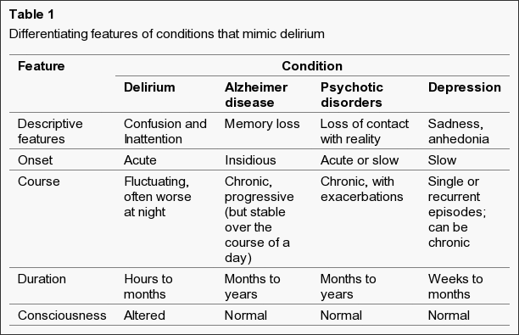
Fong, T.G., Tulebaev, S.R. and Inouye, S.K., 2009. Delirium in elderly adults: diagnosis, prevention and treatment. Nature Reviews Neurology, 5(4), p.210.

Slide 20
A Model of Delirium
A multifactorial syndrome that arises from an interrelationship between
Predisposing factors→ a patient’s underlying vulnerability
and
Precipitating factors→ noxious insults
Often no one single cause - multifactorial

Slide 21
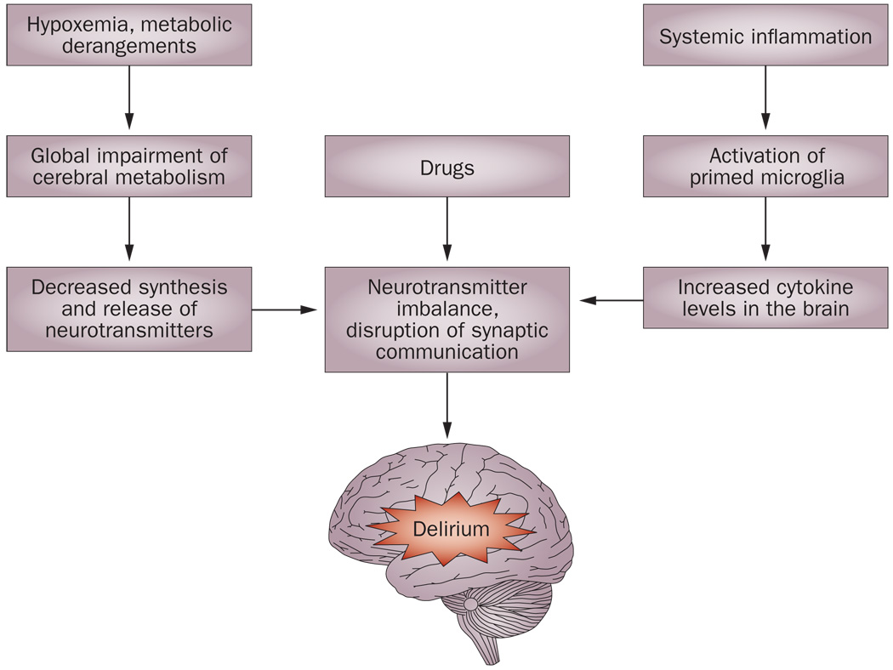
Fong, T.G., Tulebaev, S.R. and Inouye, S.K., 2009. Delirium in elderly adults: diagnosis, prevention and treatment. Nature Reviews Neurology, 5(4), p.210.

Slide 22
Predisposing Factors
Baseline cognitive impairment
2.5 fold increased risk of delirium in dementia patients
25-31% of delirious patients have underlying dementia
Medical comorbidities:
Any medical illness
Visual impairment
Hearing impairment
Functional impairment
Depression
Advanced age
History of alcohol abuse
Male gender

Slide 23
Precipitating Factors
Medications
Bedrest
Indwelling catheters
Physical restraints (also a proxy for severity)
Iatrogenic events
Uncontrolled pain
Fluid/electrolyte abnormalities
Infections
Surgery
Medical illnesses
Urinary retention and faecal impaction
Alcohol and drug withdrawal
Environmental influences

Slide 24
Medication Related Precipitating Factors
Anticholinergics
Opiates
Benzodiazepines
Corticosteriods
Alcohol withdrawal
Sedative-hypnotic drug withdrawal
Any newly prescribed medication
Over the counter (OTC) “home remedies,” especially those with anticholinergic effects (NSAIDS, nasal sprays, cold and flu meds)
Addition of 3 newly prescribed medications

Slide 25
History is crucial
When did the change in mental status begin?
Does the condition change over a 24-hour period?
Is there a change in the person’s sleep patterns?
What specific thought problems have been noticed?
Is there a history of mental illness or similar thought disturbance?
Has there been a sudden decline in physical function or a new onset of falls?
Any recent changes to medications?
Collateral hx if vital ‘what is normal’ for this patient
Avoid trap of labelling prematurely as dementia

Slide 26
Delirium “Work Up”
REMEMBER THAT DELIRIUM IS A MEDICAL EMERGENCY!
PHYSICAL EXAMINATION IMPERRATIVE
Vital signs
Cardiovascualr,respiratory and GI
Neurological examination
Hydration and nutritional status
Evidence of sepsis
Evidence of alcohol abuse and/or withdrawal

Slide 27
Key to Effective Management
Examine for signs of:
Hypoxia
Volume depletion/overload
Cardiovascular injury
Metabolic encephalopathy
Alcohol withdrawal
Hypo- or hyperthermia
New onset incontinence
Urinary retention or faecal impaction

Slide 28
Key to Effective Management
Review medication list!
Baseline laboratory studies:
Urinalysis
Blood Investigations – FBC / U&Es / LFTs / TFT / ESR / CRP / Glucose / ABGs / blood Cultures
Further diagnostic testing (based on exam):
Neuroimaging
ECG
Chest X-Ray
EEG – (When difficult to differentiate delirium from acute psychotic state)
EEG typically shows slowing of alpha rhythms, the emergence of theta waves, and eventually bilaterally symmetrical predominantly frontal delta waves

Slide 29
Non-Pharmacological Approaches
Presence of family members
Interpersonal contact and reorientation
Provide visual and hearing aids
Remove indwelling devices: i.e. Foley catheters
Mobilize patient early
A quiet environment with low-level lighting
Uninterrupted sleep

Slide 30
Delirium: Maximising Cognition
Re-orientating strategies
Inclusion of orienting facts in normal conversation
Discussion of current events
Discussion of specific interests
Structured reminiscence
Word games
Cognitive stimulation

Slide 31
Management: Hyperactive Delirium
There is no pharmacological treatment of delirium
Use drugs only if absolutely necessary: harm, interruption of medical care
First line agent: haloperidol (IV, IM, or PO)
For mild delirium:
Oral dose: 0.25-0.5 mg
IV/IM dose: 0.125-0.25 mg
For severe delirium: 0.5-1 mg IV/IM
Patient will likely need 2-5 mg total as a loading dose
May use olanzapine and risperidone
(Lonergan E et al. Cochrane Database Syst Rev. 2007 Apr 18; (2))
NB – check NICE guideline (olanzapine or haloperidol)

Slide 32
Haloperidol
WHAT SIDE EFFECTS WOULD YOU MONITOR FOR?
QT prolongation
Risk of ventricular arrhythmias
Consider getting a baseline ECG
This medication is ‘off label’ without an ECG
Extrapyramidal side effects
Acute dystonia
Parkinsonism
Akathisia
Neuroleptic malignant syndrome
Orthostatic hypotension (falls)
Over-sedation

Slide 33
Lorazepam
Second line agent
Reserve for:
Sedative and alcohol withdrawal
Parkinson’s Disease
Neuroleptic Malignant Syndrome

Slide 34
AVOID RESTRAINT AT ALL COSTS
Measure of LAST resort

Slide 35
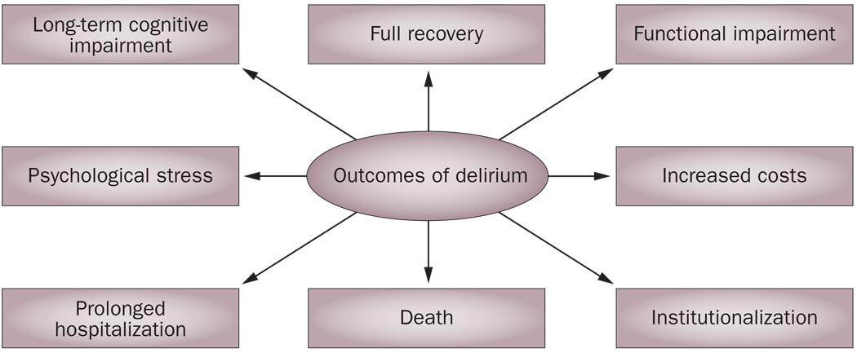
Outcomes
Fong, T.G., Tulebaev, S.R. and Inouye, S.K., 2009. Delirium in elderly adults: diagnosis, prevention and treatment. Nature Reviews Neurology, 5(4), p.210.

Slide 36
Outcome
Poor prognosis in the elderly
Independently associated with:
Increased functional disability
Increased length of hospital stay
Greater likelihood of admission to long-term care institution
Increased mortality
1 month: 16%
6 months: 26%
Symptoms often persist 6 months later

Slide 37
Discussion Point
Delirium often persists 6 months later or even longer
Acute services not really designed for effective delirium management – ward environment, staffing levels etc
Pressure to discharge patients who are ‘medically optimized’ (but may not be mentally optimized)
Medical ward – ongoing treatable medical factors?
Psychiatric ward – if severe persistent behavioral and psychiatric disturbance?
Short term care – residual features but not safe to return home?
Ideally need ‘delirium rehab’

Slide 38
Summary
A multifactorial syndrome: predisposing vulnerability and precipitating insults
Delirium can be diagnosed with high sensitivity and specificity using the CAM
Prevention should be our goal
If delirium occurs, treat the underlying causes
Always try nonpharmacological approaches first
Use low dose antipsychotics in severe cases

Slide 39
Selected references
Delirium: prevention, diagnosis and management, NICE guidelines [CG103]
Breitbart, W., Marotta, R., Platt, M.M., Weisman, H., Derevenco, M., Grau, C., Corbera, K., Raymond, S., Lund, S. and Jacobsen, P., 2005. A double-blind trial of haloperidol, chlorpromazine, and lorazepam in the treatment of delirium in hospitalized AIDS patients. Focus, 153(2), pp.231-340.
Heneghan, C. and O'Sullivan, J., 2020. Antipsychotics for preventing and treating delirium: not recommended. BMJ Evidence-Based Medicine.

Slide 40
Online resources
http://www.europeandeliriumassociation.com/
http://www.scottishdeliriumassociation.com/
https://deliriumnetwork.org/resources/
https://drshibleyrahman.wordpress.com/
https://www.the4at.com/
https://www.youtube.com/watch?v=BPfZgBmcQB8&feature=youtu.be
https://deprescribing.org/
Please provide feedback/suggestions on this presentation to the module lead Anthony.Peter@lancashirecare.nhs.uk

Slide 41
Old Age Module
MCQs
Which of the following is most frequently observed in delirium?
A. Hallucinations
B. Disturbed sleep-wake cycle
C. Labile mood
D. Increased motor activity
E. Systematised delusions

Slide 42
Old Age Module
MCQs
Which of the following is most frequently observed in delirium?
A. Hallucinations
B. Disturbed sleep-wake cycle
C. Labile mood
D. Increased motor activity
E. Systematised delusions

Slide 43
Old Age Module
MCQs
Delirium increases the risk of developing dementia:
No increase
Five-fold
Eight-fold
20-fold
30-fold

Slide 44
Old Age Module
MCQs
Delirium increases the risk of developing dementia:
No increase
Five-fold
Eight-fold
20-fold
30-fold
Davis, D.H., Muniz Terrera, G., Keage, H., Rahkonen, T., Oinas, M., Matthews, F.E., Cunningham, C., Polvikoski, T., Sulkava, R., MacLullich, A.M. and Brayne, C., 2012. Delirium is a strong risk factor for dementia in the oldest-old: a population-based cohort study. Brain, 135(9), pp.2809-2816.

Slide 45
Old Age Module
MCQs
Which of the following is not a risk factor for delirium:
Recent surgery
Poor sight
Terminal illness
Pre-existing memory problems
Intellectual disability

Slide 46
Old Age Module
MCQs
Which of the following is not a risk factor for delirium:
Recent surgery
Poor sight
Terminal illness
Pre-existing memory problems
Intellectual disability

Slide 47
Old Age Module
MCQs
Which is a clinical feature common to both dementia and delirium:
Rapid onset
Global cognitive impairment
Clouding of consciousness
Clear consciousness
Gradual onset over 6 months

Slide 48
Old Age Module
MCQs
Which is a clinical feature common to both dementia and delirium:
Rapid onset
Global cognitive impairment
Clouding of consciousness
Clear consciousness
Gradual onset over 6 months

Slide 49
Old Age Module
MCQs
Which assessment rating tool does NICE recommend using to assess for delirium:
MOCA
CAM
MMSE
ACEIII
DAS21

Slide 50
Old Age Module
MCQs
Which assessment rating tool does NICE recommend using to assess for delirium:
MOCA
CAM
MMSE
ACEIII
DAS21

Slide 51
Old Age Module
Any Questions?
Thank you

