Slide 1

MRCPsych General Adult Module
Depression
(Semester 1)

Slide 2
GA Module: Depression - 1
Aims and Objectives
The overall aim is for the trainee to gain an overview of depression.
By the end of the sessions, trainee should have:
  Developed an understanding of the clinical presentation of depression
  Developed an understanding of aetiological theories and epidemiology of depression

Slide 3
GA Module: Depression - 1
Expert Led Session
Depression – 1
Aetiological theories and epidemiology

Slide 4
Facts about Depression
Major depression is thought to be the second leading cause of disability worldwide and a major contributor to the burden of suicide and ischemic heart disease.¹
In 2013, depression was the second leading cause of years lived with a disability worldwide, behind lower back pain.²
Mental health and behavioural problems (e.g. depression, anxiety and drug use) are reported to cause over 40 million years of disability in 20 to 29-year-olds.³
1 Whiteford, H. A. et al. (2013) Global burden of disease attributable to mental and substance use disorders: findings from the Global Burden of Disease Study 2010. The Lancet. 382 (9904). pp. 1575-1586
2 Ferrari, A.J., Charlson, F.J., Norman, R.E., Patten, S.B., Freedman, G., Murray, C.J.L.,& Whiteford, H.A., (2013). Burden of Depressive Disorders by Country, Sex, Age, and Year: Findings from the Global Burden of Disease study 2010. PLOS Medicine, 10(11).
3 Lozano, R. et al. (2012) Global and regional mortality from 235 causes of death for 20 age groups in 1990 and 2010. a systematic analysis for the global burden of disease study 2010. The Lancet. 380(9859), pp. 2095–2128.
Notes:
Mental health problems are a growing public health concern. They are prevalent not just in the UK, but around the world.

Slide 5
Epidemiology
Mixed anxiety and depression is the most common mental disorder in Britain¹
Depression affects 1 in 5 older people¹
8-12% of the population experience depression
in any year²
Point (1-month), 12-month, and lifetime
estimates for major depressive disorder
in community surveys of the European Union³
Life time risk 21% - 24%
Life time prevalence 15.1%
12 month prevalence 6.5%
1 month prevalence 3.1%
1 Mental health Foundation – www.mentalhealth.org.uk
2 The Office for National Statistics Psychiatric Morbidity report, 2001
3. Wittchen HU, Jacobi F. Size and burden of mental disorders in Europe—a critical review and appraisal of 27 studies. Eur Neuropsychopharmacol. 2005;15: 357-376.

Slide 6
Epidemiology
Prevalence of depression in England
More common in women in most age groups
  Most cases with depression emerged between the ages of 12 and 25 years, with a significant gender difference apparent at around age 14 years
Approximately 2% of men and 3% of women in England are suffering from depression in a given week.
Notes:
2007

Slide 7
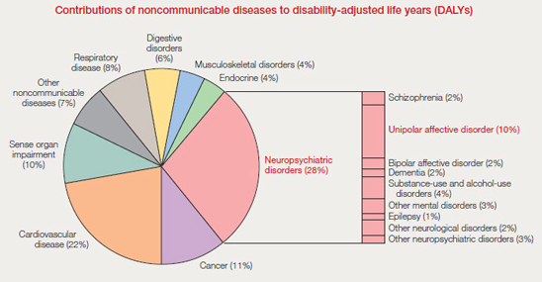
Epidemiology
WHO - General Health Care Study, 14 countries⁴
Frequency of depression in the community
  2.6% in Nagasaki to 16.9% in Manchester and 29.5% in Santiago
4th most important contributor to the global burden of disease
4. World Health Organisation – www.who.int
Notes:
Adults aged 15 to 44 years – depression is the leading cause of DALYs (disability-adjusted life years) lost worldwide.⁴

Slide 8
Epidemiology
Health care services used for depressive episode.⁵
7.2% of consecutive adult attendees in general practice had a depressive disorder⁶
5. Adult Psychiatric Morbidity in England 2007 NHS information centre for health and social care 2009
6. Ostler K et al. B J Psychiatry 2001;178: 12-17

Slide 9
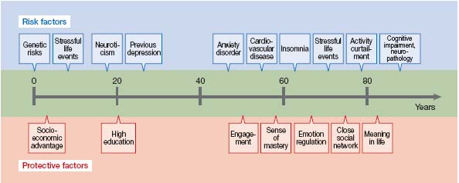
Epidemiology
Risk factor and Resilience model for depression over the human lifespan.⁷
7. Fiske A, Wetherell JL, Gatz M. Annu Rev Clin Psychol. 2009;5:363-389

Slide 10
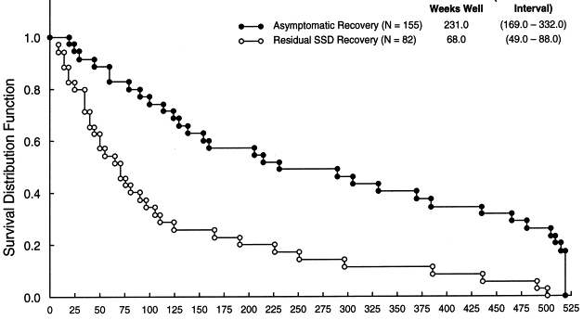
Epidemiology
Survival analysis of weeks to major depressive episode relapse (MDE): comparing patients with unipolar major depressive disorder who recovered from intake MDE with residual subsyndromal depressive symptoms vs. asymptomatic status. Wilcoxon Chi Square Test of Difference=47.96; P<0.0001

Slide 11
Epidemiology
Why Is Achieving Remission Important?
Residual symptoms put patients at high risk of relapse and recurrence
  Patients with residual symptoms after medication treatment are 3.5 times more likely to relapse compared to those fully recovered (Judd et al, 1998)
  This risk is greater than the risk associated with having ≥ 3 prior depressive episodes
  Similar finding exists after response to cognitive therapy

Slide 12
Epidemiology
Considerable cross-cultural similarities in depressive symptomatology with⁴
  low mood, anhedonia, anxiety, lack of energy in most cultures.
Cross-cultural differences do exist⁴: for example,
  feelings of guilt are one of the major symptoms of depression in Western countries
  Somatic complaints were more common in Asians.
Depression is common in
patients with physical illness.⁸
Disease | Prevalence
Older cancer patients | 25%
Post Stroke patients | 5-50%
Post MI patients | 30%
Alzheimer's dementia pts | 33%
Parkinsons patients | 50%
4. World Health Organisation – www.who.int
8. Rao Mprimary Psychiatry vol 15:No 9 2008

Slide 13
Aetiology of depression
Biochemical
Genetic
Psychodynamic
Social
Unknown
Neuroendocrine

Slide 14
Aetiology
Biochemical
Genetic
Psychodynamic
Social
Unknown
Neuroendocrine

Slide 15
Aetiology - Genetics
MDD-RU Major depressive disorder – recurrent unipolar
Twin studies - heritability at 37% ¹⁰
2 – 4 fold increased risk among first-degree relatives Heritable phenotype - early onset and a high degree of recurrence
There is no universal susceptibility gene - several candidate genes have been suggested to be implicated¹¹
Serotonin | Brain-derived neurotrophic factor | Other
Serotonin transporter gene: 5HTT/SLC6A4 | BDNF gene: Val66Met polymorphism | APOE (apolipoprotein E)
Serotonin receptor gene: HTR2A |  | GNB3 (guanine nucleotide-binding protein β-3),
Tryptophan Hydroxylase gene: TPH2 -polymorphism (Arg441His) |  | MTHFR (methylene tetrahydrofolate reductase),
10. Genetic epidemiology of major depression: review and meta-analysis. Sullivan PF, Neale MC, Kendler KS Am J Psychiatry. 2000 Oct; 157(10):1552-62
11. Overview of the genetics in major Depressive Disorder Curr Psychiatry Rep Dec 2010. 12(6), 539-546

Slide 16
Aetiology
Biochemical
Genetic
Psychodynamic
Social
Unknown
Neuroendocrine

Slide 17
Aetiology – Biochemical
Signal transmission through the neural synapse
Neurotransmitters | Availability + metabolism | Decreased serotonin, Dopamine and Noradrenaline
Receptors | Number or density | 5-HT₂ upregulation, Increased presynaptic a2-adrenergic receptors
 | Affinity + sensitivity | 5-HT_{1A} desensitisation
Post receptor systems | Number + activity of G proteins | increase of G protein
 | 2nd messenger systems | Hypofunction of the AC-cAMP kinases pathway
 | Transcription factors | Decrease expression of BDNF and CREB (cAMP response element binding protein)

Slide 18
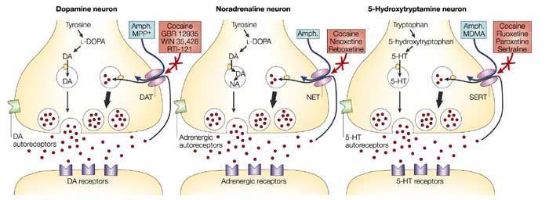
Aetiology
Biochemical
  Monoamine theory of depression
    Decreased Serotonin, Dopamine, and Noradrenaline
  Decreased GABA – Increased Glutamate

Slide 19
Aetiology
Biochemical
Noradrenaline
Serotonin
Dopamine
Energy
Evidence for theory – Antidepressant mechanism of action
Neurochemicals associated with the phenotypic presentation of depression
Motivation
Anxiety
Irritability
Mood
Emotion
Cognition
Appetite
Libido

Slide 20
Aetiology
Biochemical
Genetic
Psychological
Social
Unknown
Neuroendocrine

Slide 21
Aetiology - Neuroendocrine
Increased function of the hypothalamic-pituitary-adrenal (HPA) axis
Abnormalities of the HPA axis in patients with depression
Cortisol hypersecretion
Decreased glucocorticoid receptor sensitivity
Abnormal circadian rhythms of cortisol
Increased CSF corticotrophin releasing factor
Increased circulating ACTH
Increased adrenal gland size

Slide 22
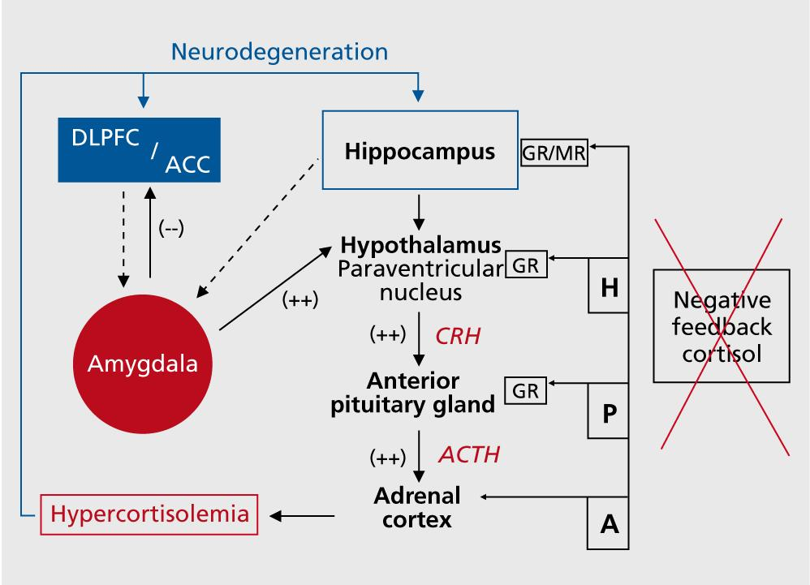
Aetiology
Diminished activity in the prefrontal cortex (DLPFC and dorsal ACC)
Enhanced activity in the amygdala
Hyperactivity in limbic areas results in higher neural activities at the hypothalamic level, evoking higher corticotrophin-releasing hormone (CRH) secretions, resulting in elevations of cortisol levels.
Hypercortisolemia due to:
Hippocampal dysfunction -reduction of the inhibitory regulation of the HPA axis.

Slide 23
Aetiology - Other biological theories
Endothelial dysfunction and platelet activation
Pro inflammatory states
Structural and functional brain changes
  Neuroimaging
    Limbic activation – subgenual cingulate, amygdala, anterior insula
    Neocortical deactivation – prefrontal cortex, inferior parietal
    Basal ganglia deactivation – caudate and putamen

Slide 24
Aetiology - Psychological
Cognitive triad – Becks
Errors in logic
  Depressed people often draw
  illogical conclusions when they
  evaluate themselves
Thoughts
What we think affects how we feel
Behaviour
What we do affects how we feel and think
Emotions
How we feel affects what we think and do

Slide 25
Aetiology - Social
    Independent and additive effect
Social isolation
Lack of social support
Stressful life experiences
Financial stress , unemployment
Chronic health problems
Childhood trauma and abuse
Substance misuse

Slide 26
Summary
Biochemical
Neuroendocrine
Genetic
Psychological
Social
Other?

Slide 27
GA Module: Depression - 1
Any Questions?
Thank you…. MCQs are next....

Slide 28
GA Module: Depression - 1
MCQ
1. Which of the following is not a well-recognised symptom of depressive illness:
Ruminations of guilt
Thought broadcast
Irritability
Thoughts of worthlessness
Hypersomnia

Slide 29
GA Module: Depression - 1
MCQ
The correct answer is: B. Thought broadcast
Explanation: Psychosis in a depression is almost always mood congruent, and in the elderly is often nihilistic ('I am dead', 'My intestines don't work'). It is unusual to have a first rank symptom like thought broadcast which is more suited to a primary psychosis like Schizophrenia.
Course links: GA Depression LAPs and Mood Disorders in the Elderly LAP.

Slide 30
GA Module: Depression - 1
MCQ
2. David has chronic back pain and depression, which is not responding to SSRI antidepressants. Which one of the following is the best antidepressant of choice in this situation?
Vortioxetine
Trazodone
Venlafaxine
Bupropion
Amitriptyline

Slide 31
GA Module: Depression - 1
MCQ
The correct answer is: E. Amitriptyline
Explanation: As this patient has not responded to SSRIs, tricyclic antidepressants like Amitriptyline would be a good choice. Amitriptyline is also prescribed frequently for the treatment of neuropathic pain.
Course links: Psychopharmacology Academic Day.

Slide 32
GA Module: Depression - 1
MCQ
3. Which of the following factors is NOT associated with risk of repetition of attempted suicide?
No previous psychiatric treatment
Alcohol or drug abuse
Previous attempts at self harm
Personality disorder
Criminal record

Slide 33
GA Module: Depression - 1
MCQ
The correct answer is: A. No previous psychiatric treatment
Explanation: There are a number of risk factors for repetition of attempted suicide, these include previous attempts, having a criminal record, pre-existing EUPD and the use of alcohol/drugs.
Course links: Self Harm LAP

Slide 34
GA Module: Depression - 1
MCQ
4. Which of the following medications has RCT evidence for reduction of suicide rate?
Citalopram
Imipramine
Aripiprazole
Bupropion
Lithium carbonate

Slide 35
GA Module: Depression - 1
MCQ
The correct answer is: E. Lithium carbonate
Explanation: There is RCT evidence that links the use of Lithium with a reduction in the suicide rate.
Course links: Self Harm LAP and Psychopharmacology Academic Day.

Slide 36
GA Module: Depression - 1
MCQ
5. Which ONE of the antidepressants below is safest to use in an individual who becomes depressed following a myocardial infarction, as concluded from the SADHART trial?
Fluoxetine
Mirtazapine
Amitriptyline
Sertraline
Citalopram

Slide 37
GA Module: Depression - 1
MCQ
The correct answer is: D. Sertraline
Explanation: (Ref - Glassman AH, et al. "Sertraline treatment of major depression in patients with acute MI or unstable angina". Journal of the American Medical Association. 2002. 288(6):701-709)
Course links: General Adult Psychiatry: Session 2 - Depression I and the Psychopharmacology Academic Day.

Slide 38
GA Module: Depression - 1
Any Questions?
Thank you….

