Slide 1

MRCPsych General Adult Module
Bipolar Disorder - I

Slide 2
GA Module: BPAD - 1
Aims and Objectives
The overall aim is for the trainee to gain an increased understanding of BPAD – this is the first session
By the end of the session trainees should:
  Develop an understanding of the clinical presentation of Bipolar disorder.
  Develop an understanding of aetiological theories and epidemiology of Bipolar disorder.

Slide 3
GA Module: BPAD - 1
Expert Led Session
Bipolar Affective Disorder – Aetiological Theories and Epidemiology

Slide 4
Lecture Overview
Brief definition
A bit of history
Types of episode - ICD10
Proposed subtypes of BPAD (I-VI)
Epidemiology
Aetiology – fragments of theory, neuroanatomy, chemistry

Slide 5
Definition
A common, severe, enduring mental health condition that follows a relapsing-remitting course.
It is characterised by recurrent episodes whereby patients meet criteria for depression, (hypo)mania or mixed affective state.
These episodes may occur with or without psychotic symptoms.

Slide 6
History
Useful to see how diagnostic frameworks and treatment rationales have evolved

Slide 7
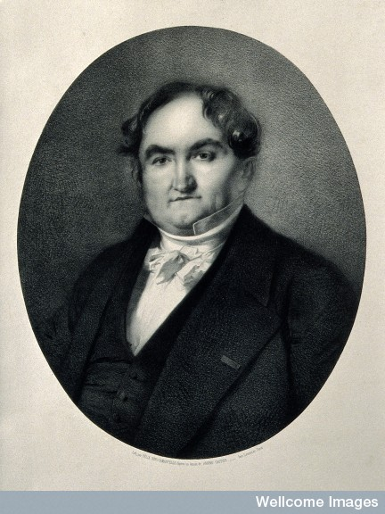
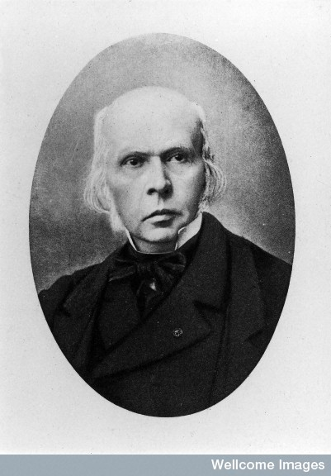
Falret
Folie circulaire 1851
Baillarger
La Folie a Double forme 1854
Notes:
Jean Pierre Falret's once celebrated but now neglected 1854 description of "circular insanity" has not been translated into English until now. This seminal essay clearly articulated for the first time the rudimentary elements of our present diagnosis of bipolar affective disorder.
Jules Baillarger (March 25, 1809 – December 31, 1890) was a French neurologist and psychiatrist. In 1854 he provided a description of a bipolar disorder that he referred to as folie à double forme (dual-form insanity).

Slide 8
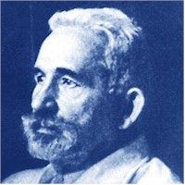
Kraepelin 1899
Manic depressive insanity
“the assertions of the patients that they are Messiah, the pearl of the world, the Bride of Christ, Queen of Heaven, Emperor of Russia, Almighty God, that they have ten thousand children.”

Slide 9
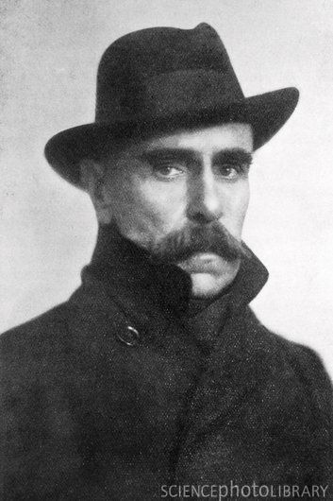
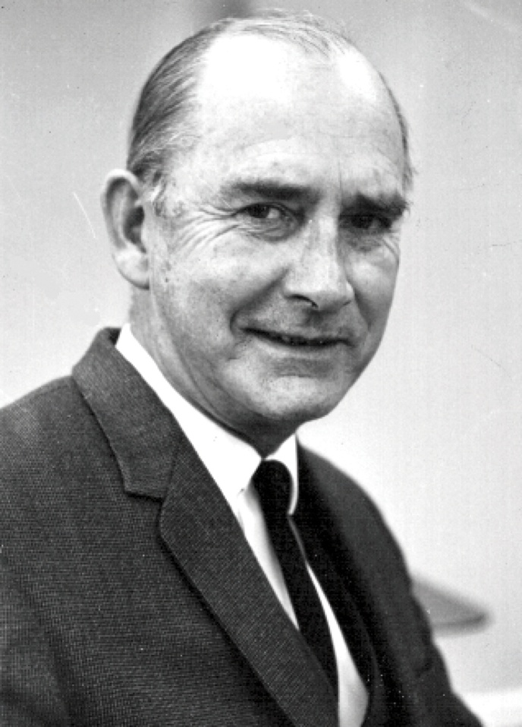
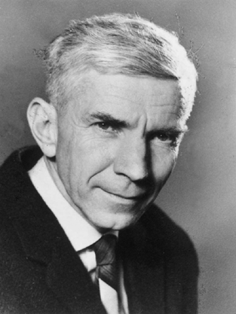
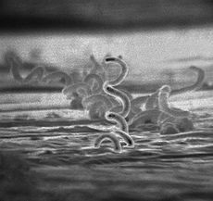
Wagner Jauregg -
Malaria cure for General paralysis of the insane. Netted him the Nobel Prize for Medicine 1927
Ronald Kuhn discovered the feel good properties of Imipramine in 1958. Also discovered its propensity for switching depression to mania
John Cade discovered mood stabilising properties of Lithium in 1949

Slide 10
ICD-10 Bipolar (Affective) Disorder
Requires at least 2 episodes, one of which must be mania/hypomania/mixed, with remission between episodes:
  Hypomania
  Mania without psychosis
  Mania with psychosis
  Mild/moderate depression
  Severe depression without psychosis
  Severe depression with psychosis
  Mixed affective episode

Slide 11
Bipolar subtypes (DSM)
I - Bipolar affective disorder (mania and depression)
II - bipolar depression (hypomania and depression)
Controversial alternatives:
Klerman lists 4 further subtypes
  III : Cyclothymia
  IV: Antidepressant induced hypo/mania
  V: Depression with family history of Bipolar I or II
  VI: Unipolar Mania

Slide 12
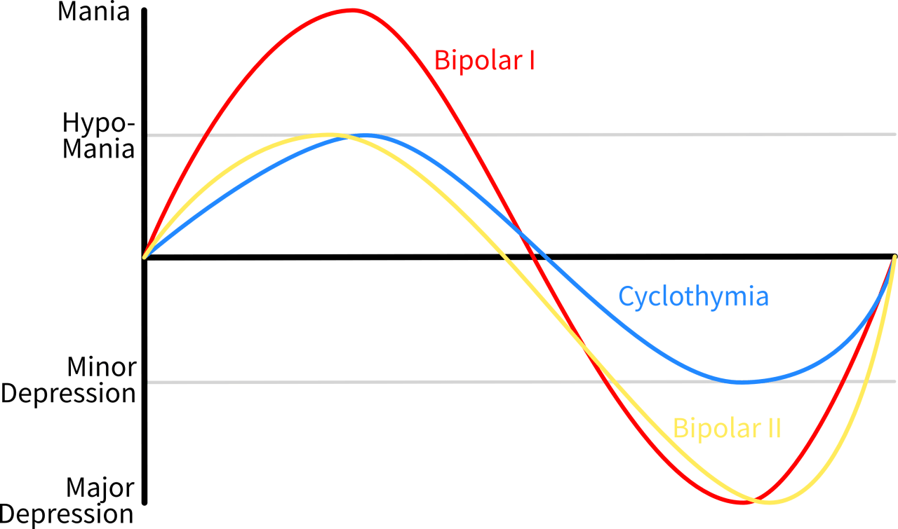
Bipolar subtypes

Slide 13
Epidemiology
Lifetime prevalence – estimates vary between 0.3% - 1.5%
Six month prevalance rates are similar to lifetime prevalence rates – reflects chronicity/recurrence
Incidence = 4 per 100 000. AESOP study suggests geographic and ethnic group variation (higher rates in London and in Black and Minority ethnic (BME) groups)

Slide 14
The AESOP data at a glance
Three cities - London, Bristol, Nottingham
Population at risk (16-64 years) = 1,631,462
 | Whole sample | White | BME
All 3 centres | 75 | 34 | 41
London | 44 | 14 | 30
Nottingham | 26 | 17 | 9
Bristol | 5 | 3 | 2
Male, n (%) | 36 (48) | 17 (50) | 19 (46)
Age at onset, years, Mean (SD) | 29.2 (9.1) | 32 (10.7) | 26.8 (6.8)
Age range (yr) | 17-56 | 17-56 | 17-50
*BME=Black and Minority Ethnic groups
Notes:
The study included all patients who contacted mental health services with first-episode psychosis or non-psychotic mania between September 1997 and August 1999 were identified and diagnosed according to ICD–10 criteria.
Reference:
Lloyd, Tuhina and Kennedy, Noel and Fearon, Paul and Kirkbride, James B. and Mallett, Rosemarie M. and Leff, Julian and Holloway, John and Harrison, Glynn and Dazzan, Paola and Morgan, Kevin D. and Murray, Robin M. and Jones, Peter B. (2005) Incidence of bipolar affective disorder in three UK cities: results from the ÆSOP Study. British Journal of Psychiatry, 186 (2). pp. 126-131. ISSN 0007-1250

Slide 15
Epidemiology
Mean age at onset = 15-27 years
  Non normal distribution so mean is misleading. Mean often early twenties but commonest age of onset in late teens.
Sex ratio = 1:1
Comorbidity - anxiety disorders, alcohol (binge drinking) and substance misuse (stimlants)

Slide 16
Risk factors for mania
- aetiology?
Genetics (high heritability)
Circadian rhythm disruption
Childbirth
Previous treatment for depression
Adverse life events
  Possibly sleep disruption rather than psychological distress associated with the event
The approach of late spring/early summer

Slide 17
Genetics
Heritability = 80-85%
First degree relatives x7-8 risk (10%)
MZ twins 60-70%, DZ twins 20%
Unipolar depression more common in relatives of BPAD probands

Slide 18
Genetics
Linkage and association analyses are commonly employed methods to locate and define susceptibility genes for diseases
Marker allele frequency in probands
  What does the association actually mean?
  Spurious false positive?
  Causal?
  Susceptibility factor?

Slide 19
Candidate gene loci
Dariers disease (12q23-24.1) cosegregates with BPAD
X linkage – factor IX and G6P deficiency association with BPAD
22q11 – COMT gene. Low activity variant associated with rapid cycling
Locations from meta analyses : 1p35-36, 4p, 4q31, 6p, 6q24, 8q, 10q, 12q, 13q, 14q, 17p, 18p, 21q, 22q

Slide 20
Genes and repeats
Genetic polymorphisms associated with BPAD
    Serotonin
      TPH1 and 2 (Tryptophan Hydroxylase)
    ARNTL (circadian rhythm gene)
    DISC1 (1q-cell proliferation/differentiation) and G72 (13q - D-serine amino acid oxidase activator) – associated with both SCZ and BPAD
CAG trinucleotide repeats- more common in BPAD and anticipation phenomena (increased severity in offspring)

Slide 21
Pathophysiology - theories
Kindling (Post 1989)
  Genetically susceptible individual experiences cumulative minor brain insults, which eventually trigger a manic episode. Neural damage sustained during this episode renders the brain vulnerable to recurrence with smaller triggers. Further injury precipitated by subsequent episodes
  ?Explains progressively shorter remissions and utility of anticonvulsants as prophylaxis
  Oxidative stress and inflammatory markers raised in BPAD

Slide 22
Pathophysiology - theories
Abnormal apoptosis levels in frontal cortex and hippocampus disrupts neural networks involved in emotional regulation (Manji 2003)
Lithium and Sodium Valproate have neurotrophic properties
  combat the above process?

Slide 23
Mapping BPAD to structure
  Limbic, striatal, hypothalamic and prefrontal circuits
  Regulation of biological drives and emotion

Slide 24
Early observations
Ventromedial PFC – motivational relevance of sensory information, behavioural adaptation
Lesions – avolition, depression, euphoria, irritability, distractibility, hypersexuality, grandiosity, paranoia
Connected to limbic and hypothalamic centres (emotion and biological drives)
R mesial temporal lesions – manic/depressive fluctuations

Slide 25
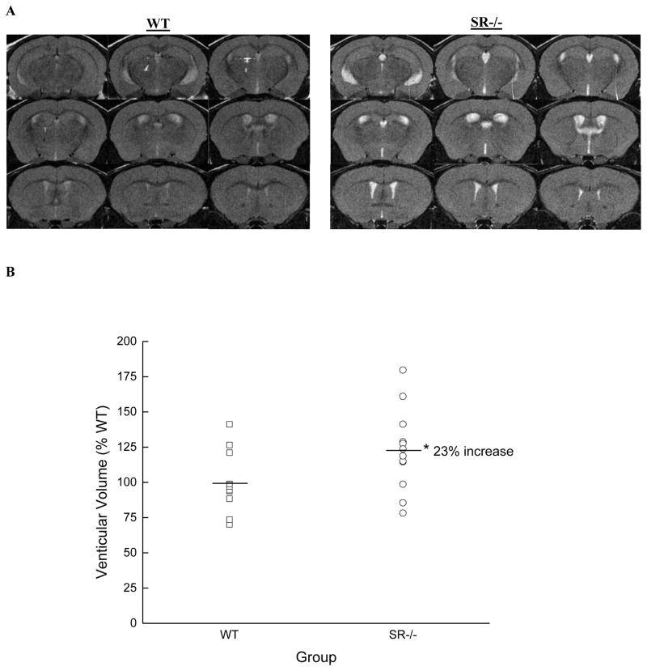
Neuroimaging data
Increased volumes of the lateral ventricles and the third ventricle and decreased cross-sectional area of the corpus callosum
Decrease in the volume of the anterior cingulate cortex
Reduced GM volume in PFC, ventral striatum and mesial temporal cotex
Prefrontal and callosal WM abnormalities
Asymmetry in Uncinate fasciculi
Shizukuishi et al. Magn Reson Med Sci, Vol. 12, No. 3, pp. 153–159, 2013
Gama et al. Rev Bras Psiquiatr. 2013;35:070-074

Slide 26
Cognition
Deficits in:
    Executive function (shifting, planning, prioritizing/updating information within working memory, decision making, response inhibition)
    Abstraction
    Sustained attention
    Verbal memory
Prefrontal and medial temporal cortices Implicated.

Slide 27
Neuroanatomy
Lesion, neuroimaging and neuropsychological data suggest that structural and functional changes in prefrontal-limbic circuitry may be associated with BPAD.
Consensus model - failure of ventral prefrontal-limbic modulation may predispose to mania.
Strakowski et al. Bipolar Disord. 2012 Jun;14(4):313-25.

Slide 28
Risk factors revisited – links to anatomy?
Candidate genes?
Circadian rhythm disruption?
Childbirth?
Adverse life events?
  Possibly sleep disruption rather than psychological distress associated with the event
The approach of late spring/early summer?

Slide 29
Mapping BPAD to chemistry
  Monoamine signalling
  Endocrine axis disruption

Slide 30
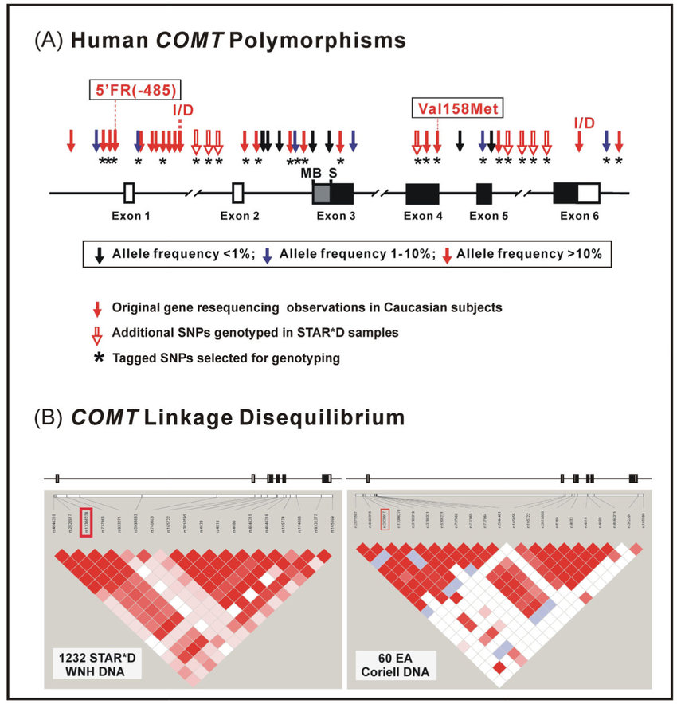
Noradrenaline (NA)
3-Methoxy-4-hydroxyphenylglycol (major metabolite of NA) levels raised in mania
Polymorphisms in tyrosine hydroxylase and COMT genes in BPAD may affect amine metabolism
Notes:
rs4680 (Val158Met) is a well studied SNP in the COMT gene. The COMT gene codes for the COMT enzyme, which breaks down dopamine in the brain's prefrontal cortex. The wild-type allele is a (G), coding for a valine amino acid; the (A) substitution polymorphism changes the amino acid to a methionine

Slide 31
Serotonin
In a nutshell, unimpressive and inconclusive data. Appears more robustly associated with depression
However – antidepressants can induce manic switch…evidence for dysregulated signalling (exaggerated response)?
Dopamine
DA agonists can function as antidepressants and precipitate mania
Catecholamine depletion studies -rebound hypomania in BPAD patients (compensatory overshoot)

Slide 32
Hormones and light
Puerperal psychosis
    Precipitous fall in Oestrogen post partum
    Increased dopamine receptor sensitivity
    Precipitous fall in CRH post partum, with subsequent ACTH and cortisol rebound
Circadian rhythm disturbance
    Clock gene polymorphisms and manic behaviour
    Sleep deprivation affects PFC function
    SSRI’s affect circadian rhythms – switch?

Slide 33
Summary
Defined
History noted
Episode types outlined
Subtypes outlined
Epidemiology overviewed
Aetiology discussed - fragments of theory, neuroanatomy, chemistry

Slide 34
GA Module: BPAD - 1
Any further questions?
MCQs are next…

Slide 35
GA Module: BPAD - 1
MCQs
1. The following statements about bipolar disorder are true except :
The lifetime risk of bipolar disorder lies between 0.3% and 1.5%.
The prevalence in men and woman is the same.
Majority of bipolar patients, particularly women, begin with a manic episode.
The age of onset is earlier in bipolar disorder than in major depressive disorder.
An onset over the age of 60 is more likely to be associated with organic brain disease.

Slide 36
Answer: C
Majority of bipolar patients, particularly women, begin with a manic episode.
Explanation: It is known that majority of bipolar patients, particularly women, begin with depressive episodes. Community surveys have estimated life time risk of bipolar disorder between 0.3% and 1.5%.Bipolar has equal sex ratio and an earlier age of onset compared with unipolar depression. The mean age of onset is about 17 years for bipolar compared with unipolar major depression, which is about 27 years. An onset over the age of 60 is more likely to be associated with organic brain disease.

Slide 37
GA Module: BPAD - 1
MCQs
2. Which of the following most closely reflects the risk of Bipolar Disorder in a first degree relative of an affected proband?
0.3-1.0%
1-2%
5-10%
15%
20%

Slide 38
GA Module: BPAD - 1
Answer: C
5-10%

Slide 39
GA Module: BPAD - 1
MCQs
3. 48 year old woman is stable on Lithium Carbonate. She has developed hypertension. Which of the following antihypertensives has the least potential for interaction with Lithium?
Losartan
Furosemide
Ramipril
Atenolol
Bendroflumethiazide

Slide 40
GA Module: BPAD - 1
Answer: D
Atenolol
Explanation: Thiazide diuretics (e.g. Bendroflumethiazide), lo& op diuretics (Furosemide), ACE inhibitors (Ramipril), angiotensin ii receptors antagonists (Losartan) may affects serum levels. Beta-blockers such as Atenolol are least likely to interact with Lithium.

Slide 41
GA Module: BPAD - 1
MCQs
4. Factors associated with a change of polarity from unipolar to bipolar include all except:
Hypersomnia and psychomotor retardation.
Absence of psychotic features.
Younger age of onset.
Family history of bipolar disorder.
Antidepressant induced hypomania

Slide 42
GA Module: BPAD - 1
Answer: B
Absence of psychotic features
One in 10 of those who begin with depressive episode go on to develop an episode of mania. The likelihood of such a switch drops markedly after the third episode of depression, by which time more than two thirds of those who will show bipolar disorder have already done so. The two main predictors are family history of bipolar disorder and an early age of onset. Others include male sex, psychotic depression, antidepressant induced hypomania, occurrence in the year after child birth (post-partum episode), hypersomnia and psychomotor retardation

Slide 43
GA Module: BPAD - 1
MCQs
5. Select one incorrect statement regarding bipolar depression in comparison with unipolar depression
Slower in onset
More frequent
More severe and shorter.
Cause greater socio-economic burden
More likely to be associated with psychotic symptoms

Slide 44
GA Module: BPAD - 1
MCQs
Which of the following statements about bipolar disorder is TRUE?
Lifetime risk is between 0.3-1.5 %
Prevalence in women is twice that in men
Mean age of onset is 30 years of age
6-month prevalence is far more than lifetime prevalence
Substance misuse is not usually a comorbid condition

Slide 45
GA Module: BPAD - 1
Answer: A
Slower in onset
Explanation: Episodes of bipolar depression are, compared with unipolar depression, more rapid in onset, more frequent, more severe, shorter, and more likely to involve psychotic symptoms, hypersomnia and hyperphagia.

Slide 46
GA Module: BPAD - 1
Any Questions?
Thank you

